Slide 1
Parameterized Complexity of Conflict-free Graph Coloring
WORKER 2019
Hans L. Bodlaender¹, Sudeshna Kolay², and Astrid Pieterse³
¹ Utrecht University, The Netherlands
² Ben Gurion University of Negev, Israel
³ Eindhoven University of Technology, The Netherlands

Slide 2
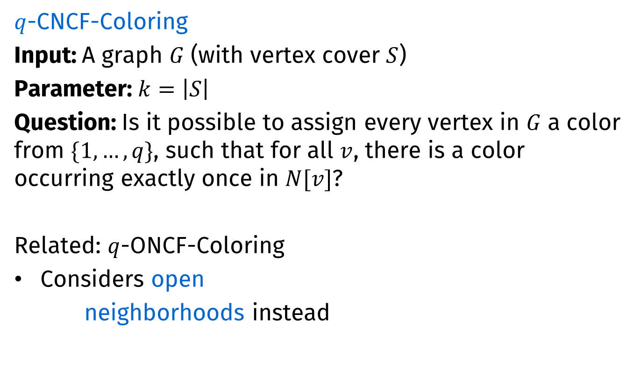
Conflict-free graph coloring
$q$-CNCF-Coloring
Input: A graph $G$ (with vertex cover $S$)
Parameter: $k=\left|S\right|$
Question: Is it possible to assign every vertex in $G$ a color from $\{1,…,q\}$, such that for all $v$, there is a color occurring exactly once in $N[v]$?
Related: $q$-ONCF-Coloring
Considers open
neighborhoods instead
$q$-Closed Neighborhood Conflict-Free Coloring
z
z
y
y
u
u
v
v
w
w
x
x

Slide 3

CNCF-Coloring
How many colors do we need to CNCF-color
A clique on $k$ vertices?
2
u
u
v
v
w
w
y
y
x
x

Slide 4

CNCF-Coloring
How many colors do we need to CNCF-color
A clique on $k$ vertices?
A bipartite graph?
2
2
2
w
w
u
u
x
x
v
v
y
y

Slide 5

CNCF-Coloring
How many colors do we need to CNCF-color
A clique on $k$ vertices?
A bipartite graph?
An odd cycle?
2
2
2
2
2
u
u
v
v
w
w
y
y
x
x

Slide 6

CNCF-Coloring
How many colors do we need to CNCF-color
A clique on $k$ vertices?
A bipartite graph?
An odd cycle?
Petersen graph
2
2
2
2
2
2
2
2
2
2

Slide 7
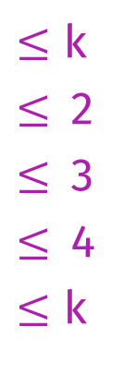

CNCF-Coloring
How many colors do we need to CNCF-color
A clique on $k$ vertices?
A bipartite graph?
An odd cycle?
Petersen graph
A $k$-colorable graph?
2
2
2
2
2
2
2
2
2
2
2
k
$≤$ k
$≤$2
$≤$3
$≤$4
$≤$ k
  Observation
  Any proper coloring is a CNCF-Coloring
  Each vertex is the uniquely colored vertex in its closed neighborhood

Slide 8
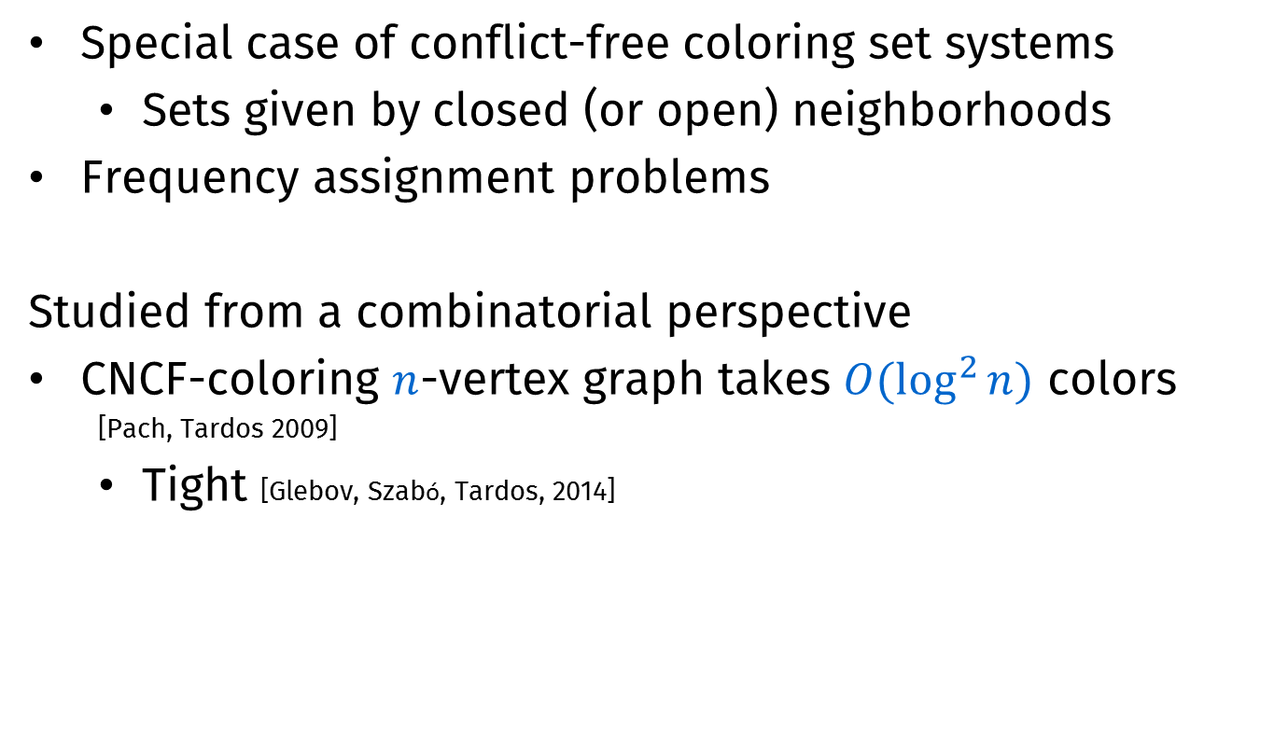
Background
Special case of conflict-free coloring set systems
  Sets given by closed (or open) neighborhoods
Frequency assignment problems
Studied from a combinatorial perspective
CNCF-coloring $n$-vertex graph takes $O(\log^{2}{n})$ colors
  [Pach, Tardos 2009]
  Tight [Glebov, Szabó, Tardos, 2014]

Slide 9
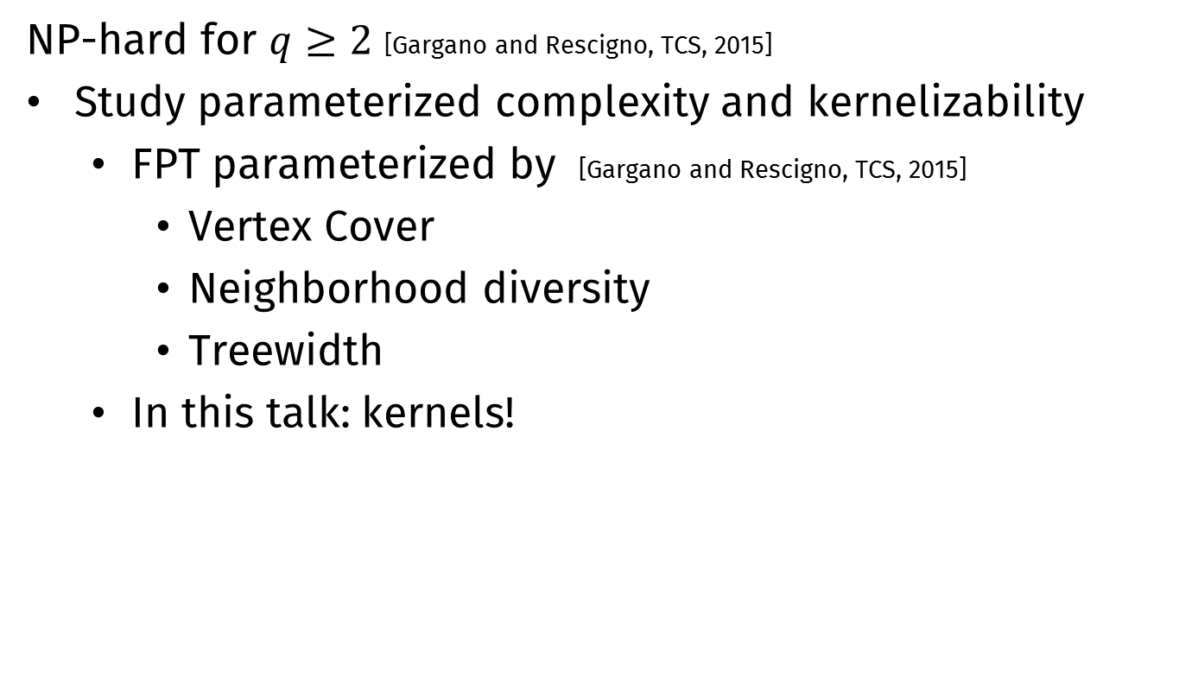
Background
NP-hard for $q≥2$ [Gargano and Rescigno, TCS, 2015]
Study parameterized complexity and kernelizability
  FPT parameterized by [Gargano and Rescigno, TCS, 2015]
    Vertex Cover
    Neighborhood diversity
    Treewidth
  In this talk: kernels!

Slide 10
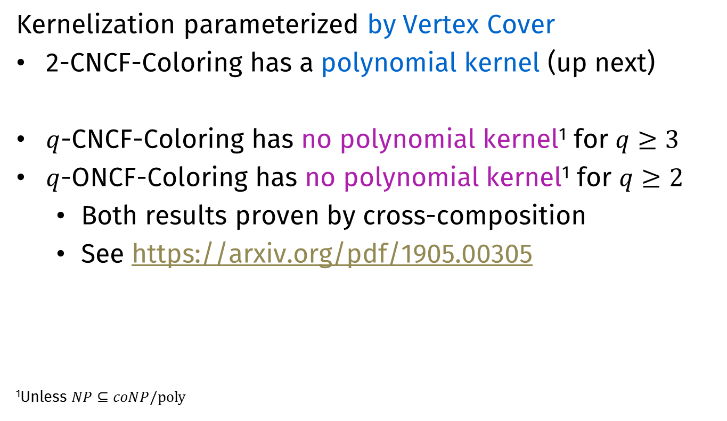
Results
Kernelization parameterized by Vertex Cover
2-CNCF-Coloring has a polynomial kernel (up next)
$q$-CNCF-Coloring has no polynomial kernel¹ for $q≥3$
$q$-ONCF-Coloring has no polynomial kernel¹ for $q≥2$
  Both results proven by cross-composition
  See https://arxiv.org/pdf/1905.00305
¹Unless $NP⊆coNP/poly$

Slide 11

A general reduction rule
For $q$-CNCF-Coloring
[Based on Gargano and Rescigno, TCS 2015, Lemma 6]
Notes:
Start at 17 min

Slide 12


Reducing number of twins
Let $S^{′}⊆S$. Suppose there are $>q+1$ vertices $v∉S$ with $N\left(v\right)=S′$. Mark $q+1$, remove the others.
$$q=3$$
s





$S$’

Slide 13







Correctness
Let $G′$ be the resulting graph
Suppose $G$ is $q$-CNCF-Colorable
  Color $G′$ similarly, ensuring that each vertex in $S$ keeps its conflict-free neighbor (if any)
$$G$$
$$G′$$
$$S$$
s
$$S$$
s
$S$’
$S$’

Slide 14

Correctness
Suppose $G′$ is $q$-CNCF-Colorable
  Use the same coloring on $G$
  Let $v$ be a removed vertex, color $v$ using a color already used twice in $N(v)$
    Observe that such a color exists!
$$G$$
$$G′$$
$$S$$
s
$$S$$
s
$S$’
$S$’

Slide 15
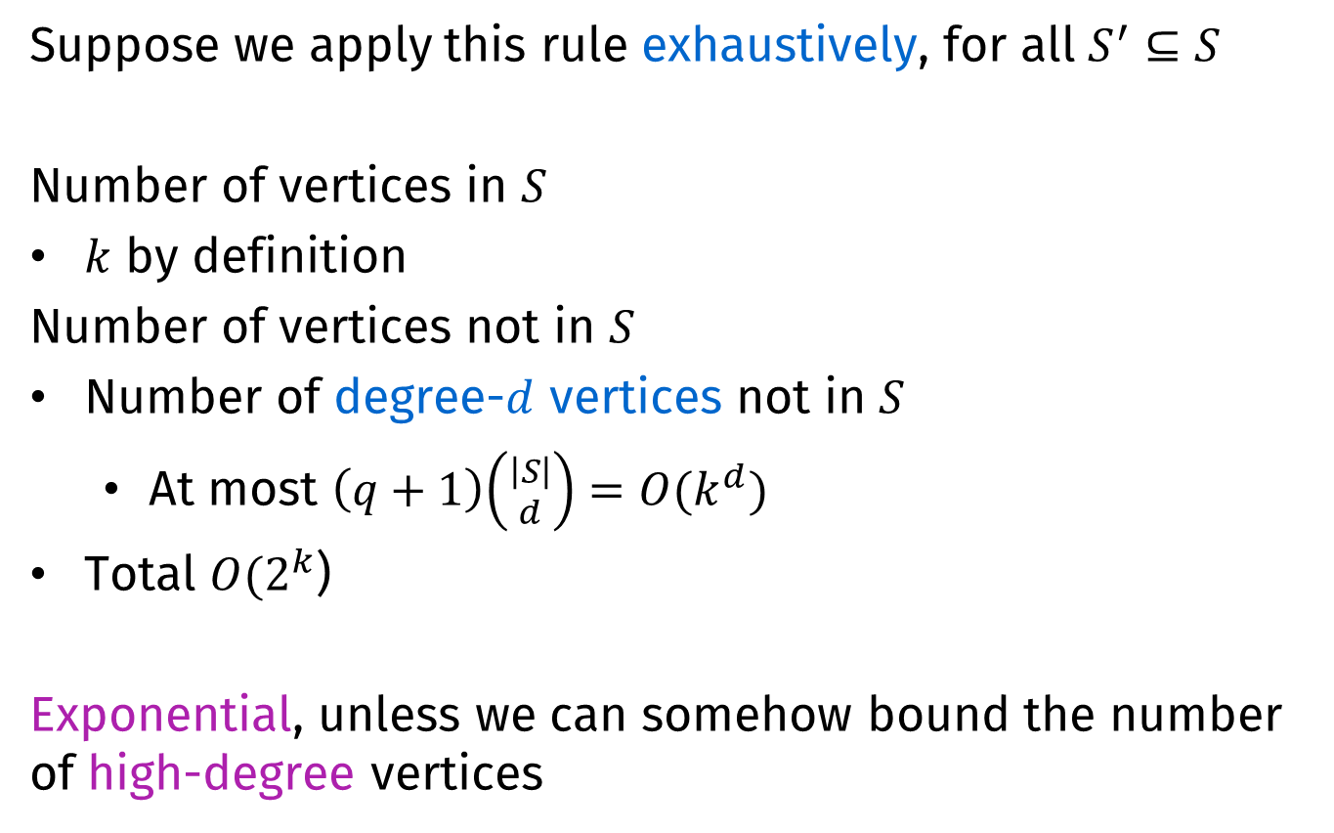
Effectiveness
Suppose we apply this rule exhaustively, for all $S^{′}⊆S$
Number of vertices in $S$
$k$ by definition
Number of vertices not in $S$
Number of degree-$d$ vertices not in $S$
  At most $\left(q+1\right)\left({\left|S\right| \atop d}\right)=O(k^{d})$
Total $O(2^{k}$)
Exponential, unless we can somehow bound the number of high-degree vertices

Slide 16
Polynomial kernel for
2-CNCF-Coloring
Extension
Parameterized by Vertex Cover size
Notes:
Start at 17 min

Slide 17
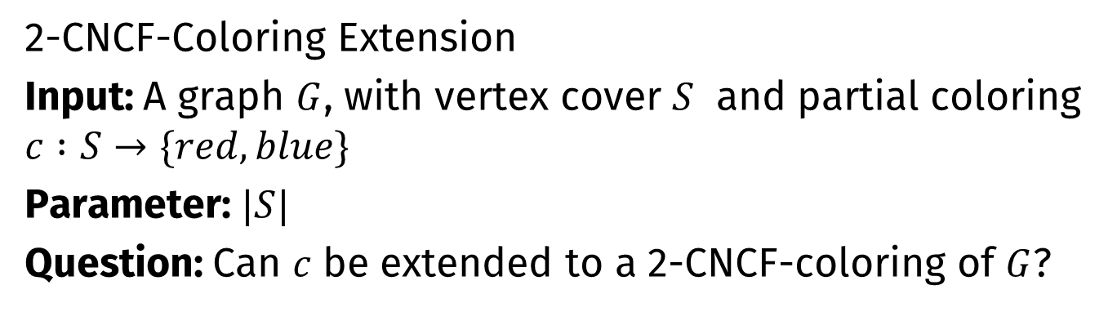
The extension problem
2-CNCF-Coloring Extension
Input: A graph $G$, with vertex cover $S$ and partial coloring $c :S→\{red,blue\}$
Parameter: $|S|$
Question: Can $c$ be extended to a 2-CNCF-coloring of $G$?
S
This is a yes-instance!

Slide 18



Trivial reduction rule
If at any point there is a vertex $v$ whose neighborhood contains at least two red and two blue vertices under $c$
Output NO
$$v$$
$$v$$

Slide 19
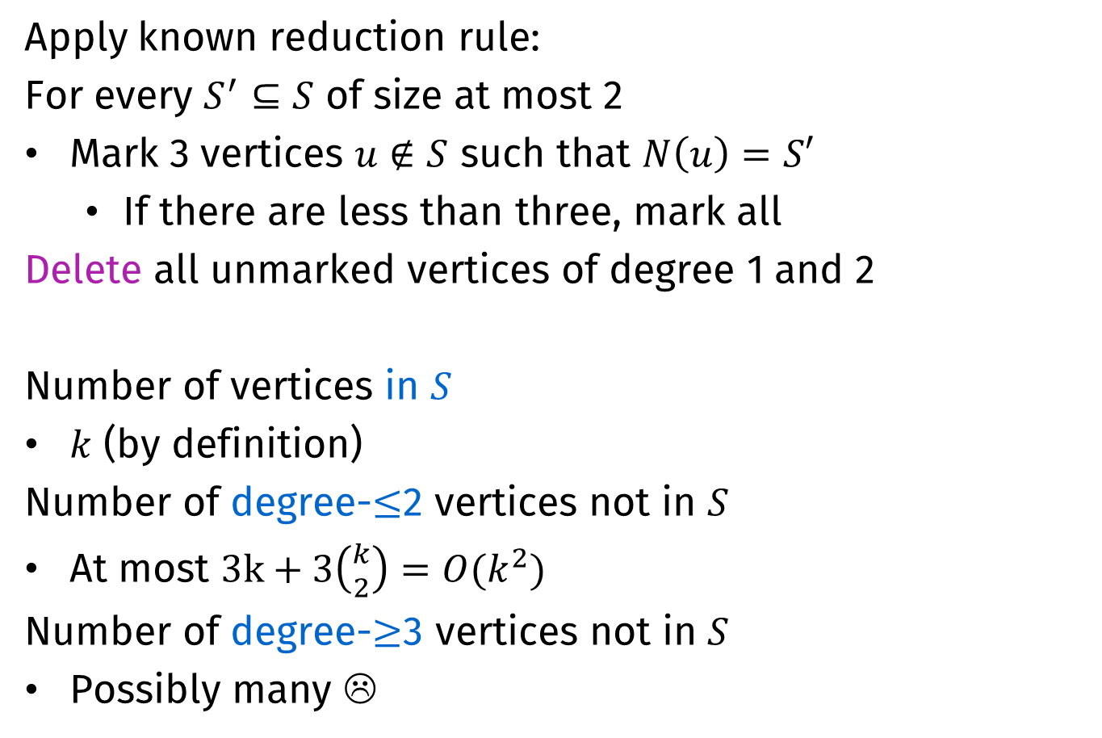
Removing low-degree vertices
Apply known reduction rule:
For every $S^{′}⊆S$ of size at most 2
Mark 3 vertices $u∉S$ such that $N\left(u\right)=S′$
  If there are less than three, mark all
Delete all unmarked vertices of degree 1 and 2
Number of vertices in $S$
$k$ (by definition)
Number of degree-$≤$2 vertices not in $S$
At most $3k+3\left({k \atop 2}\right)={O(k}^{2})$
Number of degree-$≥$3 vertices not in $S$
Possibly many ☹

Slide 20

Removing high-degree vertices
For all $v∉S$ of degree at least $3$do the following.
Extend $c$ by coloring $v$ such that $N[v]$ is conflict-free
  This uniquely determines $c(v)$
S
S
S
S

Slide 21

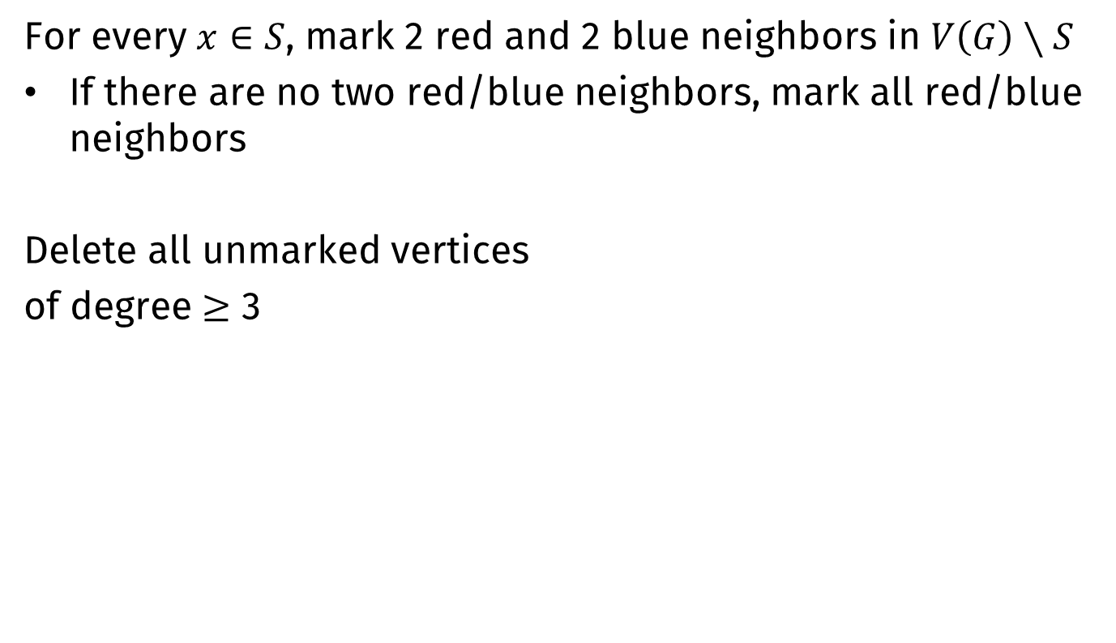

Marking procedure
For every $x∈S$, mark 2 red and 2 blue neighbors in $V\left(G\right)∖S$
If there are no two red/blue neighbors, mark all red/blue neighbors
Delete all unmarked vertices
of degree $≥$ 3
$$x$$





$$S$$

Slide 22
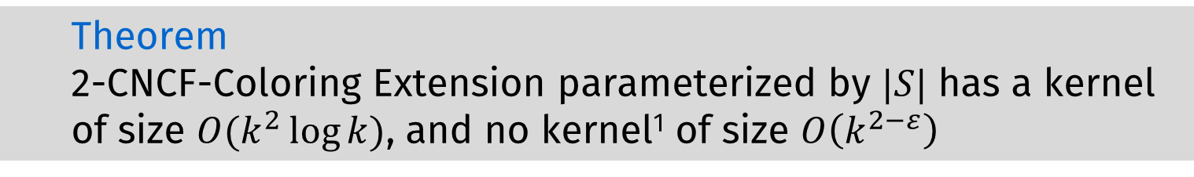
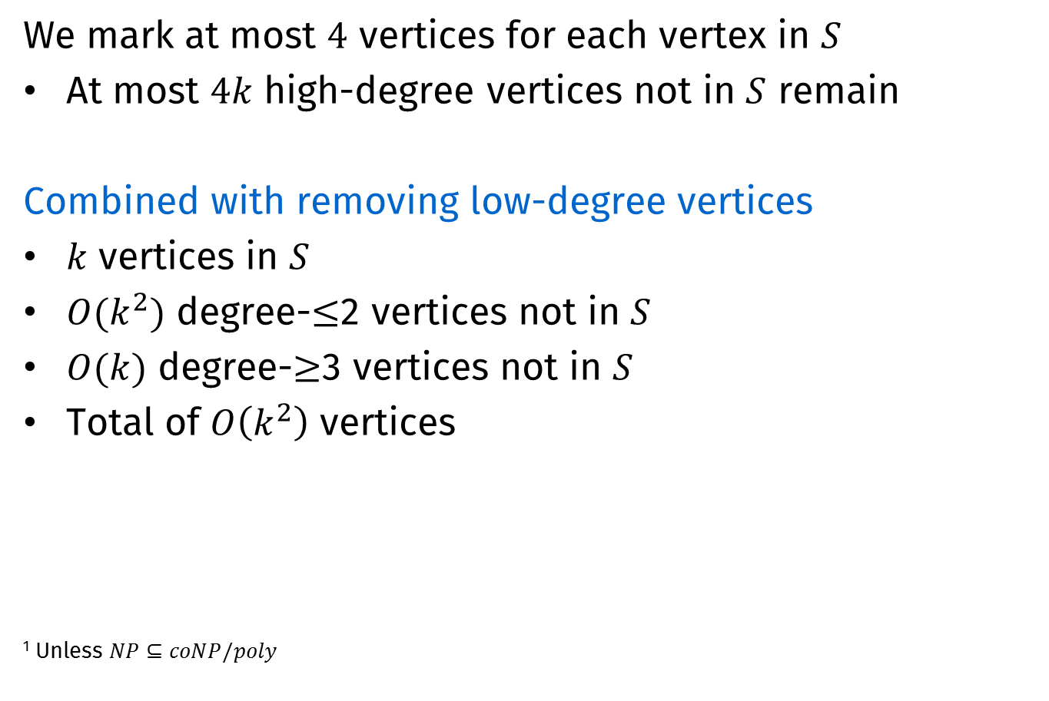
Kernel size
We mark at most $4$ vertices for each vertex in $S$
At most $4k$ high-degree vertices not in $S$ remain
Combined with removing low-degree vertices
$k$ vertices in $S$
$O(k^{2})$ degree-$≤$2 vertices not in $S$
$O(k)$ degree-$≥$3 vertices not in $S$
Total of $O\left(k^{2}\right)$ vertices
¹ Unless $NP⊆coNP/poly$
  Theorem
  2-CNCF-Coloring Extension parameterized by $|S|$ has a kernel of size $O(k^{2}\log{k})$, and no kernel¹ of size $O\left(k^{2−ε}\right)$

Slide 23
Polynomial kernel for
2-CNCF-Coloring
Parameterized by Vertex Cover size
Notes:
Start at 17 min

Slide 24
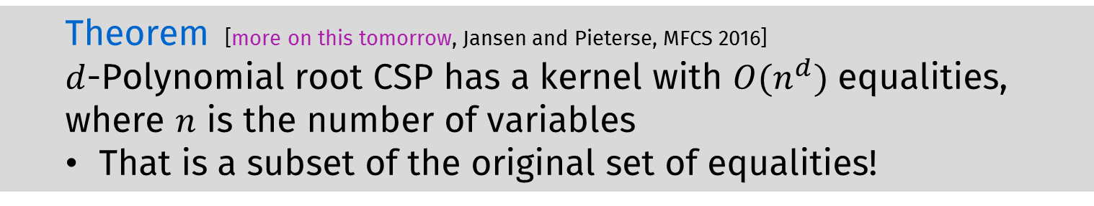
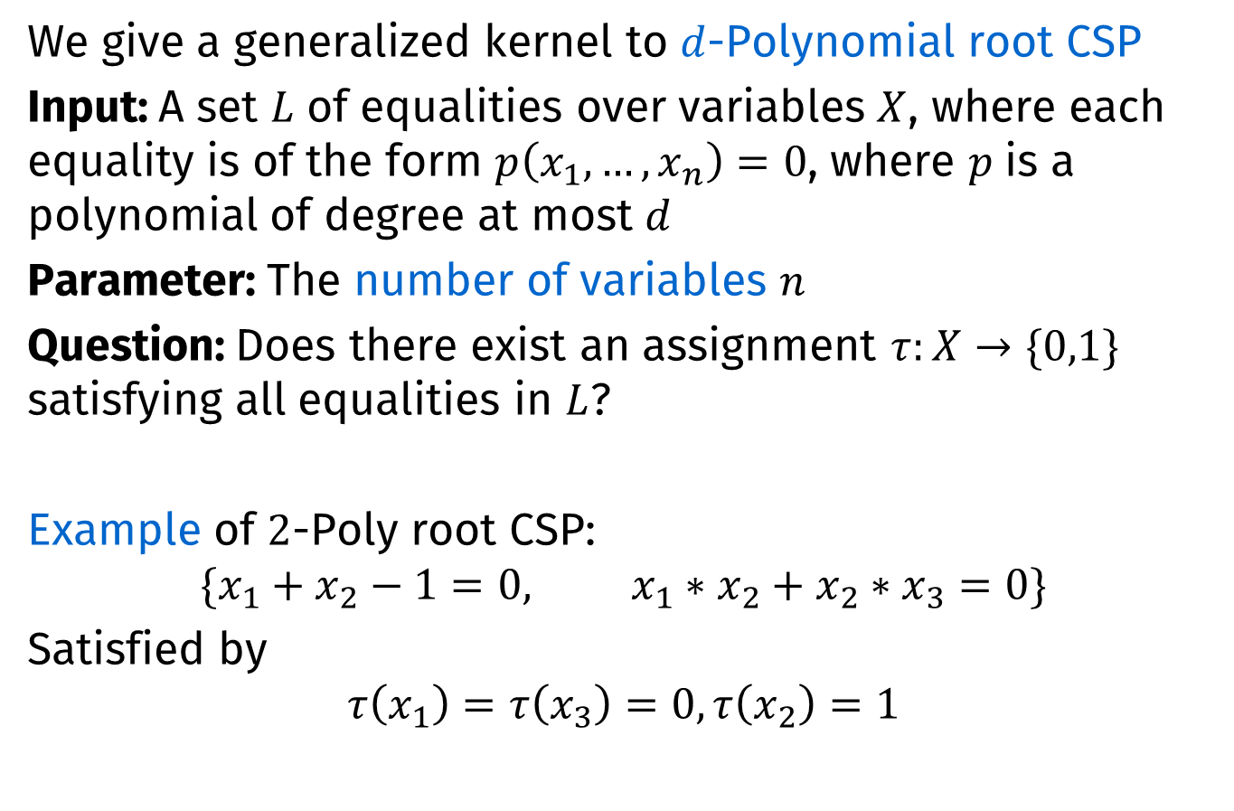
A generalized kernel
We give a generalized kernel to $d$-Polynomial root CSP
Input: A set $L$ of equalities over variables $X$, where each equality is of the form $p\left(x_{1},…,x_{n}\right)=0$, where $p$ is a polynomial of degree at most $d$
Parameter: The number of variables $n$
Question: Does there exist an assignment $τ:X→\{0,1\}$ satisfying all equalities in $L$?
Example of $2$-Poly root CSP:
$$\{x_{1}+x_{2}−1=0, {x_{1}∗x_{2}+x}_{2}∗x_{3}=0\}$$
Satisfied by
$$τ\left(x_{1}\right)=τ\left(x_{3}\right)=0, τ\left(x_{2}\right)=1$$
  Theorem [more on this tomorrow, Jansen and Pieterse, MFCS 2016]
  $d$-Polynomial root CSP has a kernel with $O(n^{d})$ equalities, where $n$ is the number of variables
  That is a subset of the original set of equalities!

Slide 25
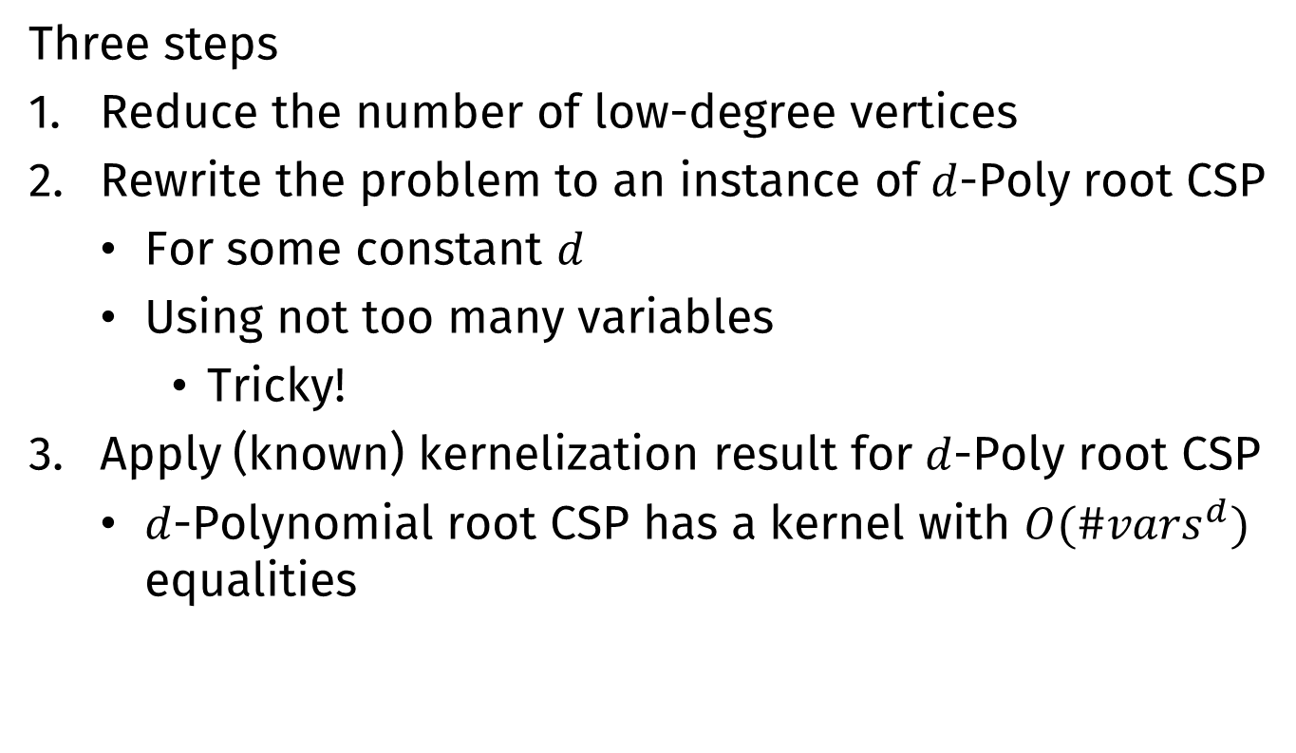
Kernelization: General idea
Three steps
Reduce the number of low-degree vertices
Rewrite the problem to an instance of $d$-Poly root CSP
  For some constant $d$
  Using not too many variables
    Tricky!
Apply (known) kernelization result for $d$-Poly root CSP
  $d$-Polynomial root CSP has a kernel with $O({\#vars}^{d})$ equalities

Slide 26
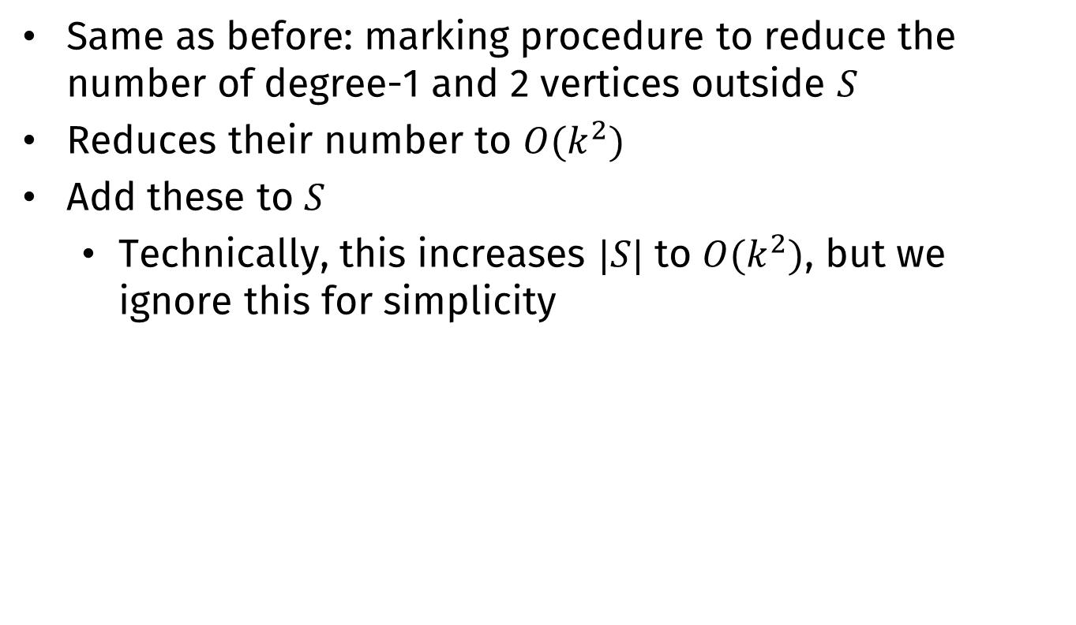
Removing low-degree vertices
Same as before: marking procedure to reduce the number of degree-1 and 2 vertices outside $S$
Reduces their number to $O(k^{2})$
Add these to $S$
  Technically, this increases $|S|$ to $O(k^{2})$, but we ignore this for simplicity

Slide 27
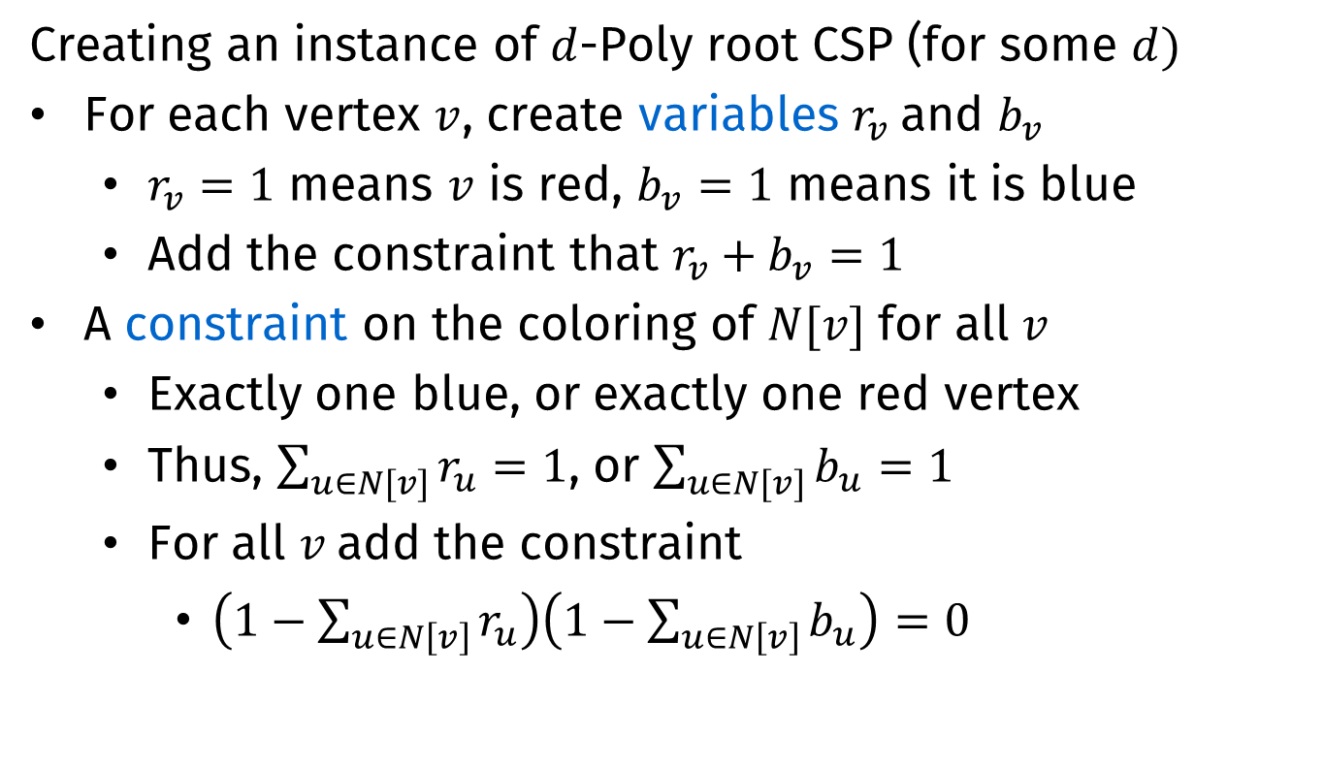
Rewriting: Basics
Creating an instance of $d$-Poly root CSP (for some $d)$
For each vertex $v$, create variables $r_{v}$and $b_{v}$
  $r_{v}=1$ means $v$ is red, $b_{v}=1$ means it is blue
  Add the constraint that $r_{v}+b_{v}=1$
A constraint on the coloring of $N[v]$ for all $v$
  Exactly one blue, or exactly one red vertex
  Thus, $\sum_{u∈N[v]}{r_{u}=1}$, or $\sum_{u∈N[v]}{b_{u}}=1$
  For all $v$add the constraint
    $\left(1−\sum_{u∈N\left[v\right]}{r_{u}}\right)\left(1−\sum_{u∈N\left[v\right]}{b_{u}}\right)=0$

Slide 28
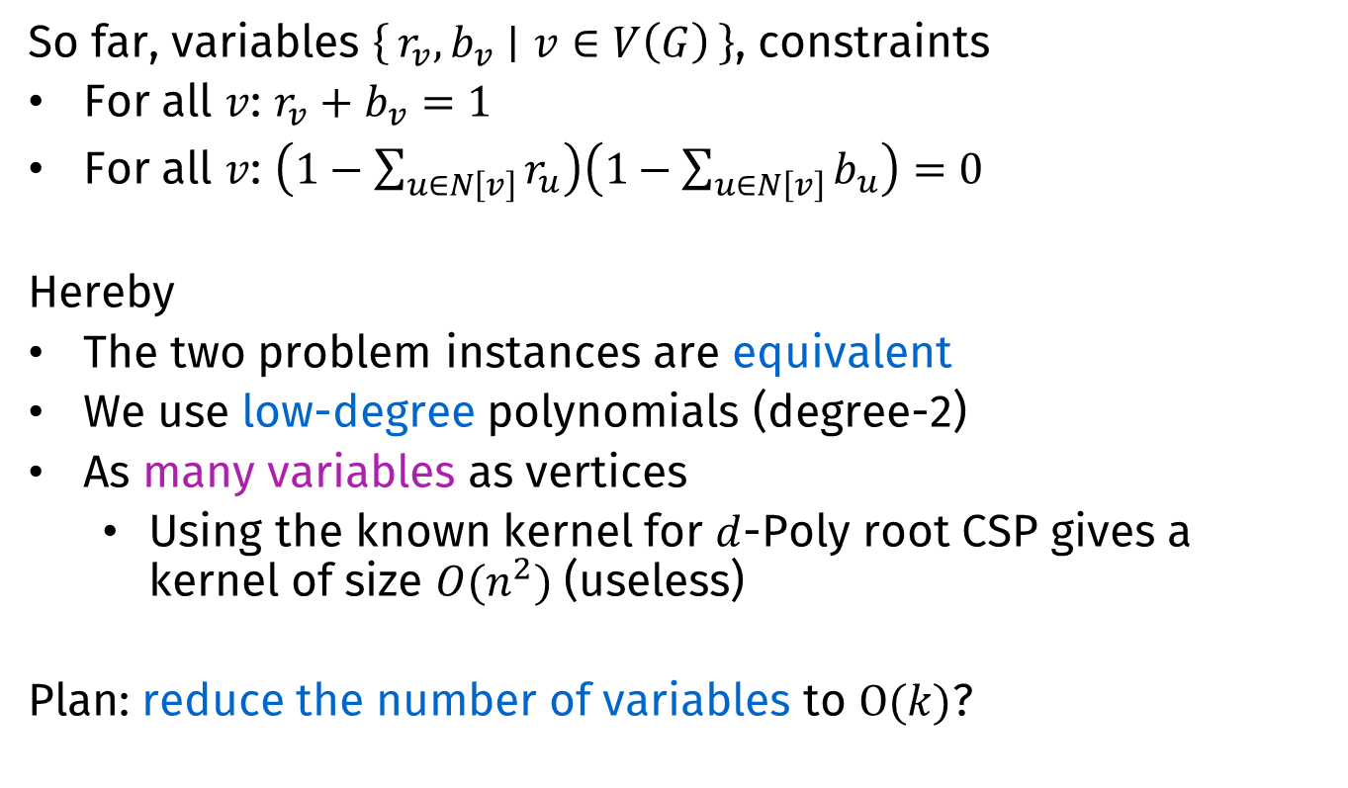
Rewriting: Continued
So far, variables $\left\{r_{v},b_{v} ∣ v∈V\left(G\right)\right\}$, constraints
For all $v$: $r_{v}+b_{v}=1$
For all $v$: $\left(1−\sum_{u∈N\left[v\right]}{r_{u}}\right)\left(1−\sum_{u∈N\left[v\right]}{b_{u}}\right)=0$
Hereby
The two problem instances are equivalent
We use low-degree polynomials (degree-2)
As many variables as vertices
  Using the known kernel for $d$-Poly root CSP gives a kernel of size $O(n^{2})$ (useless)
Plan: reduce the number of variables to $O(k)$?

Slide 29

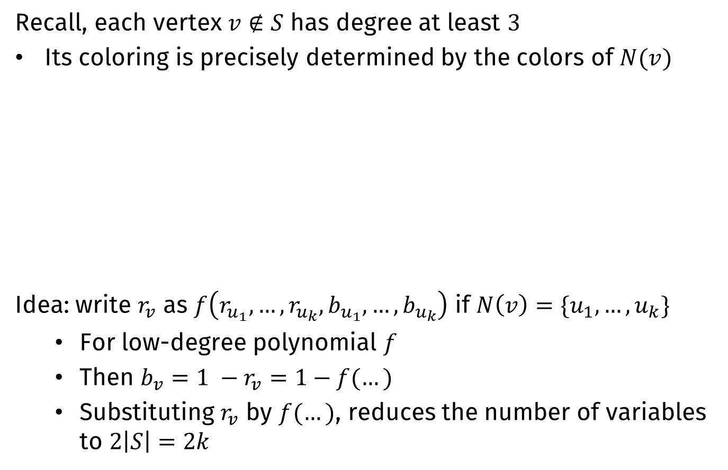



Reducing the number of variables
Recall, each vertex $v∉S$ has degree at least $3$
Its coloring is precisely determined by the colors of $N(v)$
Idea: write $r_{v}$ as $f\left(r_{u_{1}},…, r_{u_{k}},b_{u_{1}},…,b_{u_{k}}\right)$ if $N\left(v\right)=\{u_{1},…,u_{k}\}$
  For low-degree polynomial $f$
  Then $b_{v}=1 −r_{v}=1−f(…)$
  Substituting $r_{v}$ by $f(…)$, reduces the number of variables to $2\left|S\right|=2k$
S
S
S
S
$$v$$
$$v$$
$$v$$
$$v$$

Slide 30


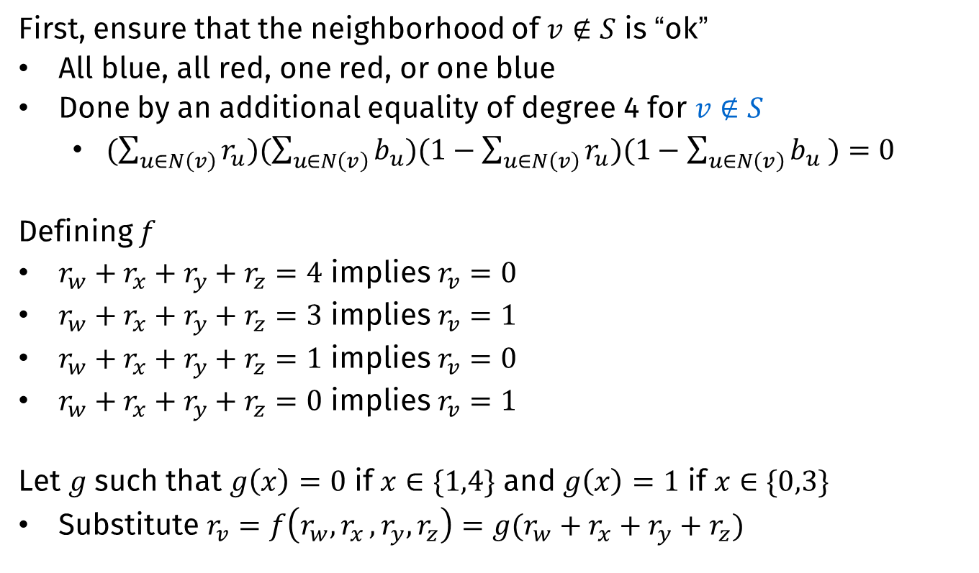



Reducing the number of variables
First, ensure that the neighborhood of $v∉S$ is “ok”
All blue, all red, one red, or one blue
Done by an additional equality of degree 4 for $v∉S$
  $(\sum_{u∈N\left(v\right)}{r_{u}})(\sum_{u∈N\left(v\right)}{b_{u}})(1−\sum_{u∈N\left(v\right)}{r_{u}})(1−\sum_{u∈N\left(v\right)}{b_{u} )}=0$
Defining $f$
$r_{w}+r_{x}+r_{y}+r_{z}=4$ implies $r_{v}=0$
$r_{w}+r_{x}+r_{y}+r_{z}=3$ implies $r_{v}=1$
$r_{w}+r_{x}+r_{y}+r_{z}=1$ implies $r_{v}=0$
$r_{w}+r_{x}+r_{y}+r_{z}=0$ implies $r_{v}=1$
Let $g$ such that $g\left(x\right)=0$ if $x∈\{1,4\}$ and $g\left(x\right)=1$ if $x∈\{0,3\}$
Substitute $r_{v}=f\left(r_{w}{,r}_{x},r_{y},r_{z}\right)=g(r_{w}+r_{x}+r_{y}+r_{z})$
$$w$$
$$x$$
$$v$$
$$y$$
$$z$$

Slide 31
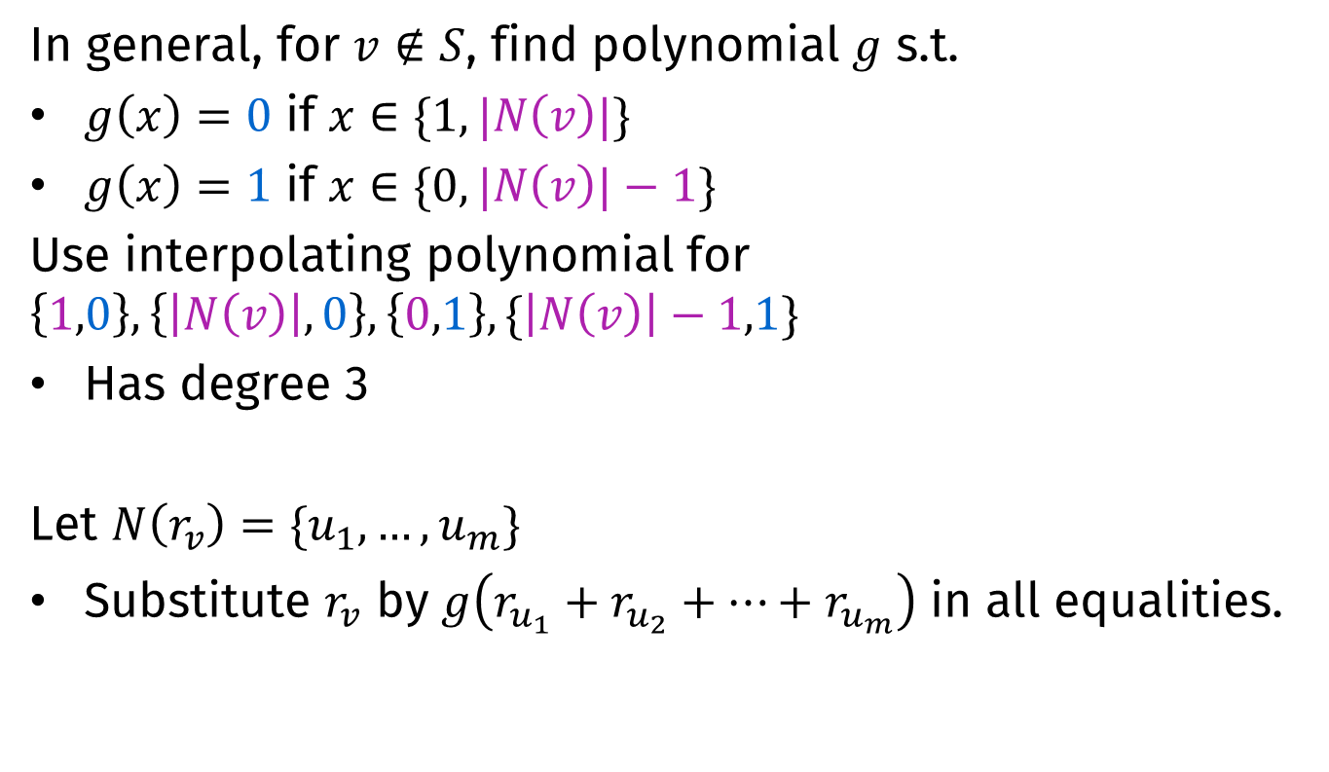
Reducing the number of variables
In general, for $v∉S$, find polynomial $g$ s.t.
$g\left(x\right)=0$ if $x∈\{1,|N\left(v\right)|\}$
$g\left(x\right)=1$ if $x∈\{0,|N\left(v\right)|−1\}$
Use interpolating polynomial for $\left\{1,0\right\},\left\{\left|N\left(v\right)\right|,0\right\},\left\{0,1\right\},\{\left|N\left(v\right)\right|−1,1\}$
Has degree 3
Let $N\left(r_{v}\right)=\{u_{1},…,u_{m}\}$
Substitute $r_{v}$ by $g\left(r_{u_{1}}+r_{u_{2}}+…+r_{u_{m}}\right)$ in all equalities.

Slide 32
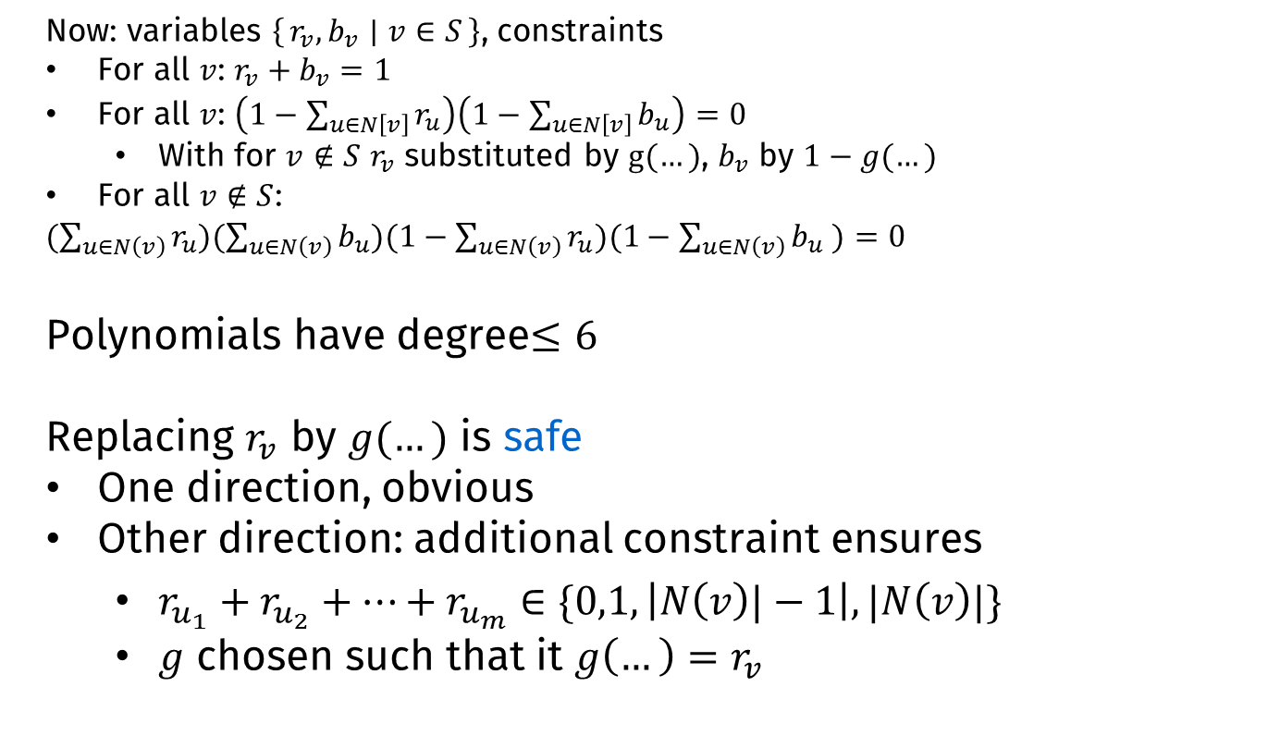
Correctness
Now: variables $\left\{r_{v},b_{v} ∣ v∈S\right\}$, constraints
For all $v$: $r_{v}+b_{v}=1$
For all $v$: $\left(1−\sum_{u∈N\left[v\right]}{r_{u}}\right)\left(1−\sum_{u∈N\left[v\right]}{b_{u}}\right)=0$
  With for $v∉S$ $r_{v}$ substituted by $g(…)$, $b_{v}$ by $1−g(…)$
For all $v∉S$:
$(\sum_{u∈N\left(v\right)}{r_{u}})(\sum_{u∈N\left(v\right)}{b_{u}})(1−\sum_{u∈N\left(v\right)}{r_{u}})(1−\sum_{u∈N\left(v\right)}{b_{u} )}=0$
Polynomials have degree$≤6$
Replacing $r_{v}$ by $g(…)$ is safe
One direction, obvious
Other direction: additional constraint ensures
  $r_{u_{1}}+r_{u_{2}}+…+r_{u_{m}}∈\{0,1,\left|N\left(v\right)|−1\right|,|N\left(v\right)|\}$
  $g$ chosen such that it $g\left(…\right)=r_{v}$

Slide 33
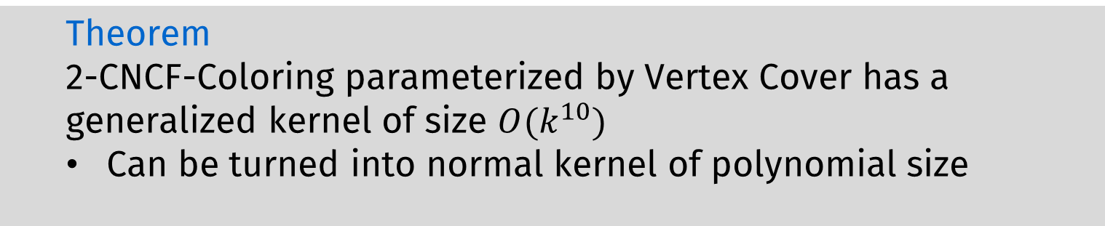
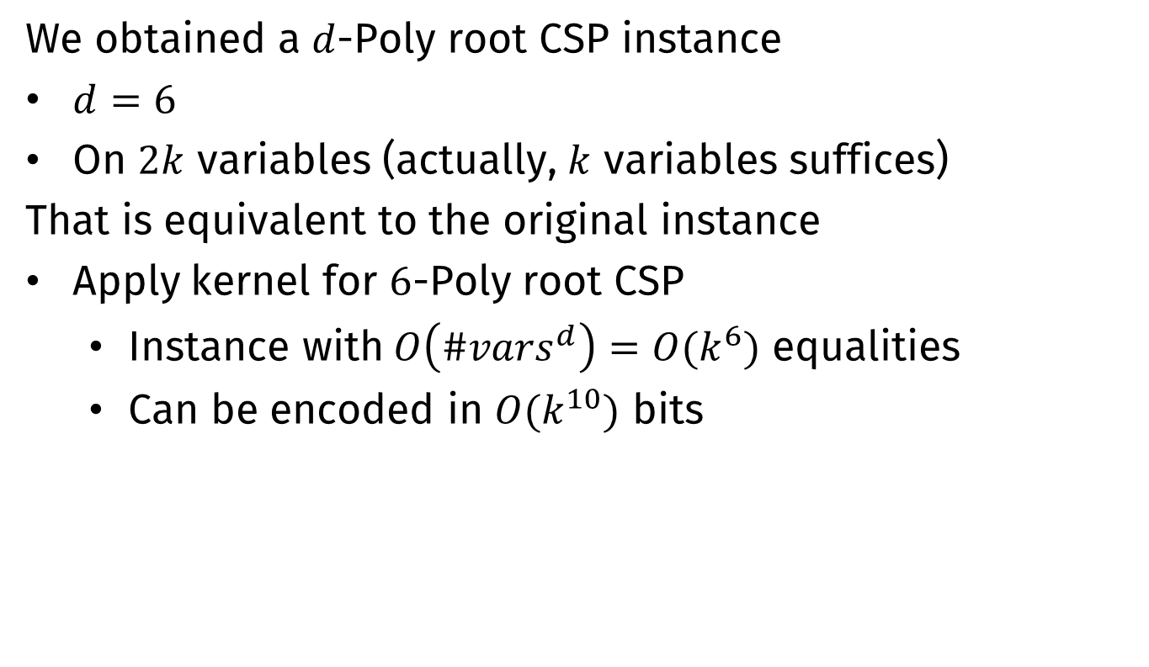
Kernelization
We obtained a $d$-Poly root CSP instance
$d=6$
On $2k$ variables (actually, $k$ variables suffices)
That is equivalent to the original instance
Apply kernel for $6$-Poly root CSP
  Instance with$O\left({\#vars}^{d}\right)=O(k^{6})$ equalities
  Can be encoded in $O(k^{10})$ bits
  Theorem
  2-CNCF-Coloring parameterized by Vertex Cover has a generalized kernel of size $O(k^{10})$
  Can be turned into normal kernel of polynomial size

Slide 34
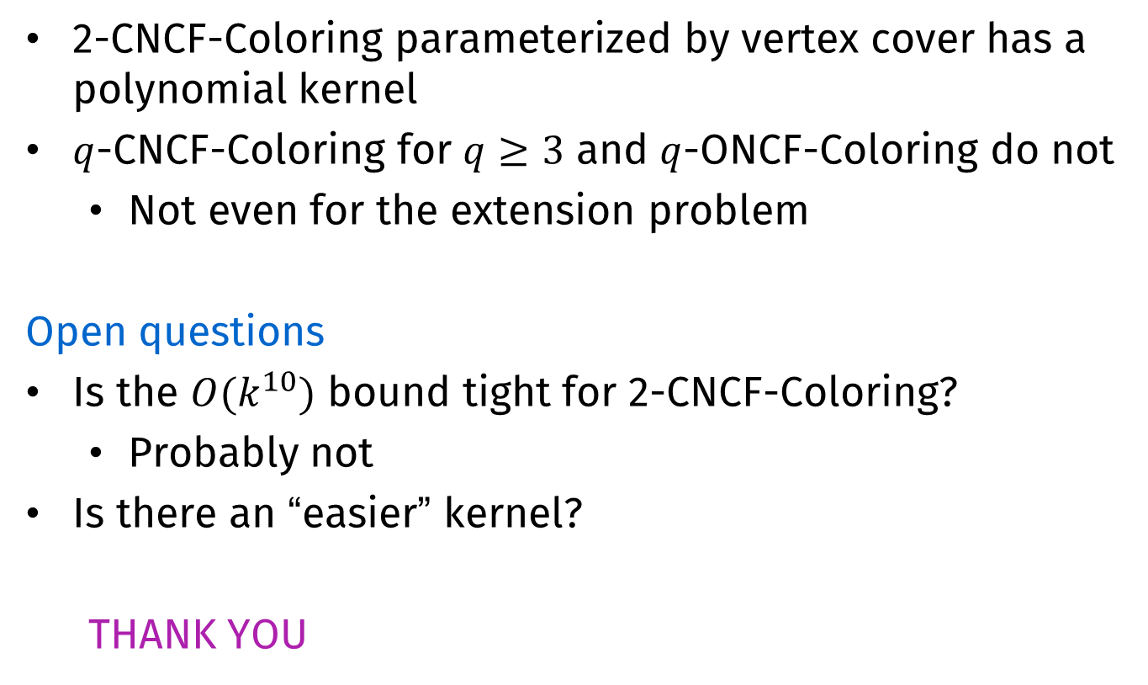
Conclusion
2-CNCF-Coloring parameterized by vertex cover has a polynomial kernel
$q$-CNCF-Coloring for $q≥3$ and $q$-ONCF-Coloring do not
  Not even for the extension problem
Open questions
Is the $O(k^{10})$ bound tight for 2-CNCF-Coloring?
  Probably not
Is there an “easier” kernel?
  THANK YOU

