Slide 1
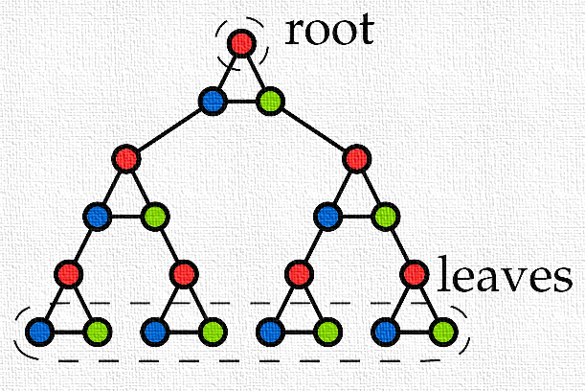
Kernelization
Astrid Pieterse

Slide 2
About me
PhD student since September 1st, 2015
Eindhoven
Supervisor: Bart Jansen
Promotor: Mark de Berg
Before that
Mathematics and Computer Science bachelor
Computer Science and Engineering Master

Slide 3
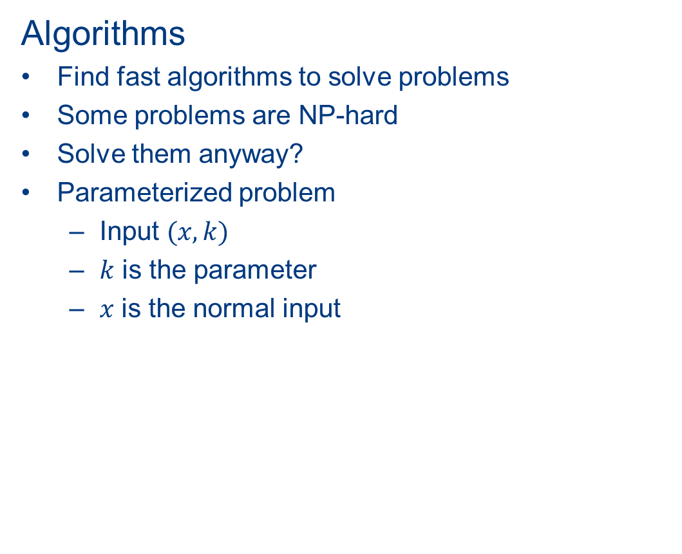
Algorithms
Find fast algorithms to solve problems
Some problems are NP-hard
Solve them anyway?
Parameterized problem
  Input $(x,k)$
  $k$ is the parameter
  $x$ is the normal input

Slide 4


What parameter?
Problem easy if $k$ small
(Almost)
acyclic?
Number
of nodes
Solution size
$$k$$

Slide 5

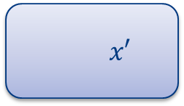




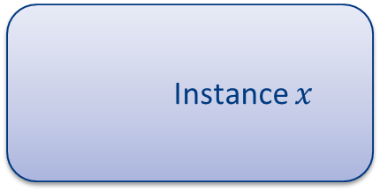
Instance $x$
$$k$$
Can we do preprocessing?
Reduce input size
Polynomial time
Size of $x′$ depends only on $k$
  and is hopefully small (polynomial)
Kernelization
Methods have been found to
Find such a preprocessing
Show it does not exist
Size $\left|x\right|+k$
$$x′$$
$$k′$$
Size $f(k)$

Slide 6

Example: Vertex Cover
Subset of vertices such that every edge is covered
Does $G$ have a vertex cover of size $k$?
Parameter: $k$
Correct vertex cover

Slide 7
Example: Vertex Cover
Subset of vertices such that every edge is covered
Does $G$ have a vertex cover of size $k$?
Parameter: $k$
Incorrect vertex cover
Not covered

Slide 8

Rules to reduce input size
$$k=3$$

Slide 9
Rules to reduce input size
Remove vertex without edges
$$k=3$$

Slide 10
Rules to reduce input size
Remove vertex without edges
$$k=3$$

Slide 11

Rules to reduce input size
Remove vertex without edges
Suppose degree > $k$
$$k=3$$

Slide 12

Rules to reduce input size
Remove vertex without edges
Suppose degree > $k$
  Add $v$ to cover, decrease $k$
$$k=3$$

Slide 13

Rules to reduce input size
Remove vertex without edges
Suppose degree > $k$
  Add $v$ to cover, decrease $k$
$$k=2$$

Slide 14

Rules to reduce input size
Remove vertex without edges
Suppose degree > $k$
  Add $v$ to cover, decrease $k$
  Remove $v$
$$k=2$$

Slide 15
Rules to reduce input size
Remove vertex without edges
Suppose degree > $k$
  Add $v$ to cover, decrease $k$
  Remove $v$
$$k=2$$

Slide 16


Rules to reduce input size
Remove vertex without edges
Suppose degree > $k$
  Add $v$ to cover, decrease $k$
  Remove $v$
Apply these rules exhaustively
  Every vertex has degree $≤k$
  By $k$ vertices we cover $≤k^{2}$ edges
2 Options
  Many edges: output $no$
  Else: instance of size $O(k^{2})$!
$$k=1$$

Slide 17
In this case, a combination of smart rules can provably shrink the instance size!
But in other cases we can prove this is impossible
Master thesis
Considered several graph problems
and one from logic

Slide 18
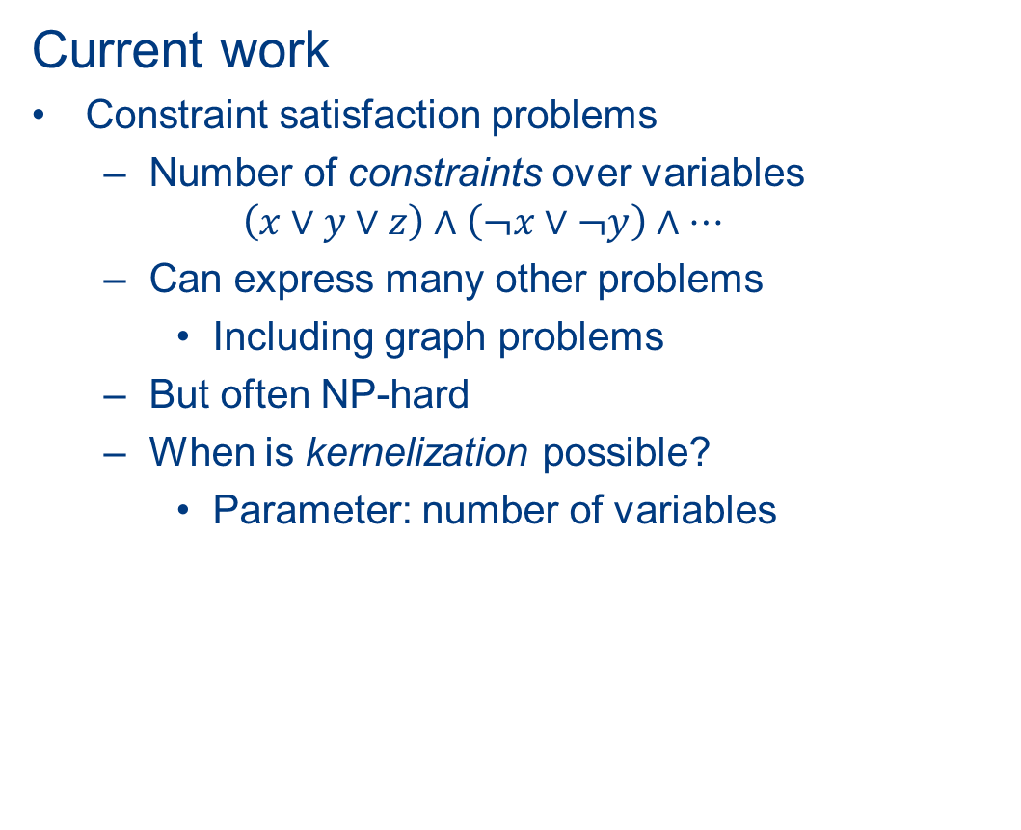
Current work
Constraint satisfaction problems
  Number of constraints over variables
  $$\left(x∨y∨z\right)∧\left(¬x∨¬y\right)∧…$$
  Can express many other problems
    Including graph problems
  But often NP-hard
  When is kernelization possible?
    Parameter: number of variables

