Slide 1
Parameterized Complexity of Conflict-free Graph Coloring
WADS 2019
Hans L. Bodlaender¹, Sudeshna Kolay², and Astrid Pieterse³
¹ Utrecht University, The Netherlands
² Ben Gurion University of Negev, Israel
³ Eindhoven University of Technology, The Netherlands

Slide 2
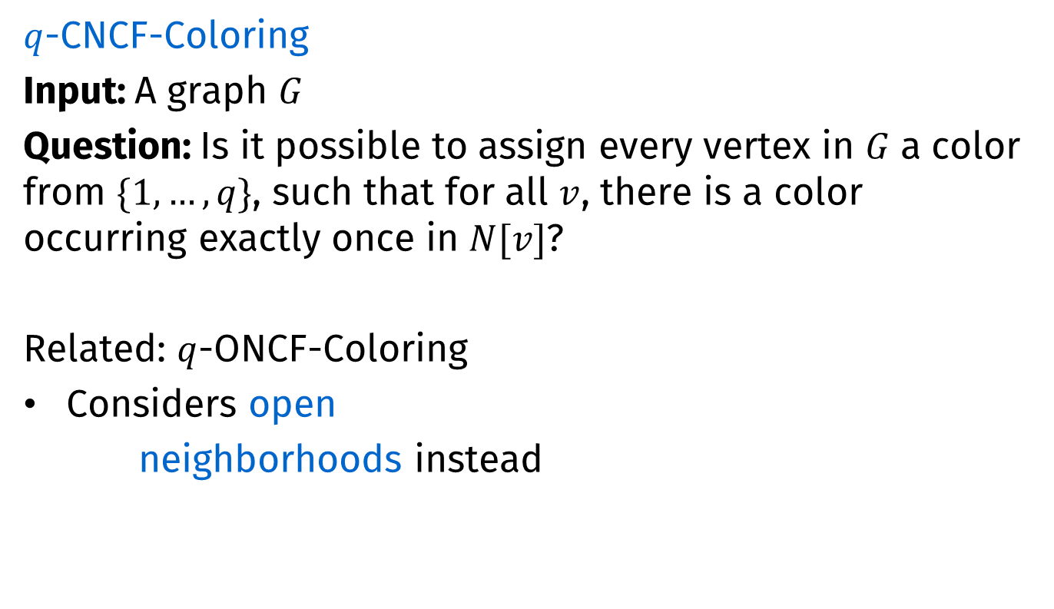
Conflict-free graph coloring
$q$-CNCF-Coloring
Input: A graph $G$
Question: Is it possible to assign every vertex in $G$ a color from $\{1,…,q\}$, such that for all $v$, there is a color occurring exactly once in $N[v]$?
Related: $q$-ONCF-Coloring
Considers open
neighborhoods instead
$q$-Closed Neighborhood Conflict-Free Coloring
z
z
y
y
u
u
v
v
w
w
x
x

Slide 3

CNCF-Coloring
How many colors do we need to CNCF-color
A clique on $k$ vertices?
2
u
u
v
v
w
w
y
y
x
x

Slide 4

CNCF-Coloring
How many colors do we need to CNCF-color
A clique on $k$ vertices?
A bipartite graph?
2
2
2
w
w
u
u
x
x
v
v
y
y

Slide 5

CNCF-Coloring
How many colors do we need to CNCF-color
A clique on $k$ vertices?
A bipartite graph?
An odd cycle?
2
2
2
2
2
u
u
v
v
w
w
y
y
x
x

Slide 6

CNCF-Coloring
How many colors do we need to CNCF-color
A clique on $k$ vertices?
A bipartite graph?
An odd cycle?
Petersen graph
2
2
2
2
2
2
2
2
2
2

Slide 7
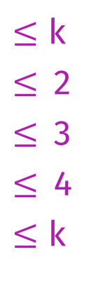

CNCF-Coloring
How many colors do we need to CNCF-color
A clique on $k$ vertices?
A bipartite graph?
An odd cycle?
Petersen graph
A $k$-colorable graph?
2
2
2
2
2
2
2
2
2
2
2
k
$≤$ k
$≤$2
$≤$3
$≤$4
$≤$ k
  Observation
  Any proper coloring is a CNCF-Coloring
  Each vertex is the uniquely colored vertex in its closed neighborhood

Slide 8
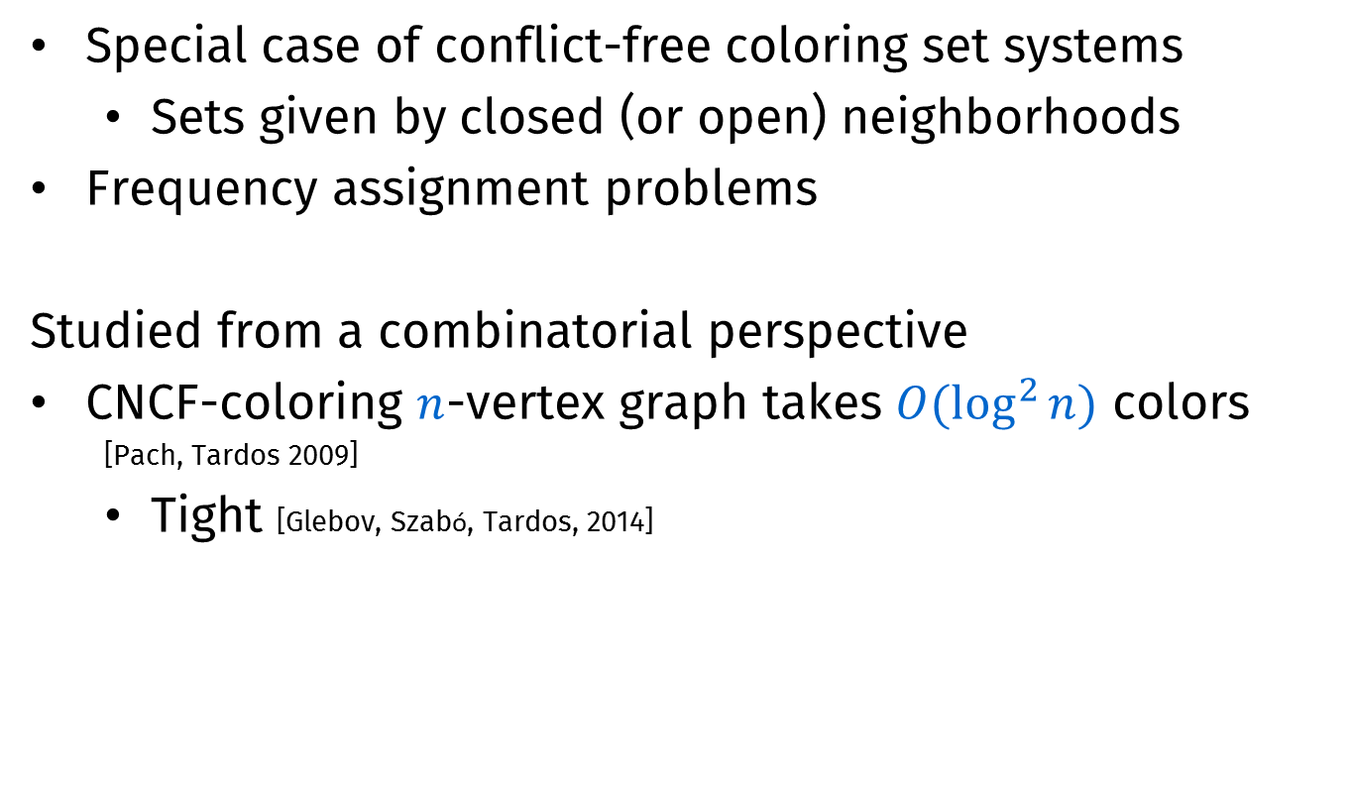
Background
Special case of conflict-free coloring set systems
  Sets given by closed (or open) neighborhoods
Frequency assignment problems
Studied from a combinatorial perspective
CNCF-coloring $n$-vertex graph takes $O(\log^{2}{n})$ colors
  [Pach, Tardos 2009]
  Tight [Glebov, Szabó, Tardos, 2014]

Slide 9
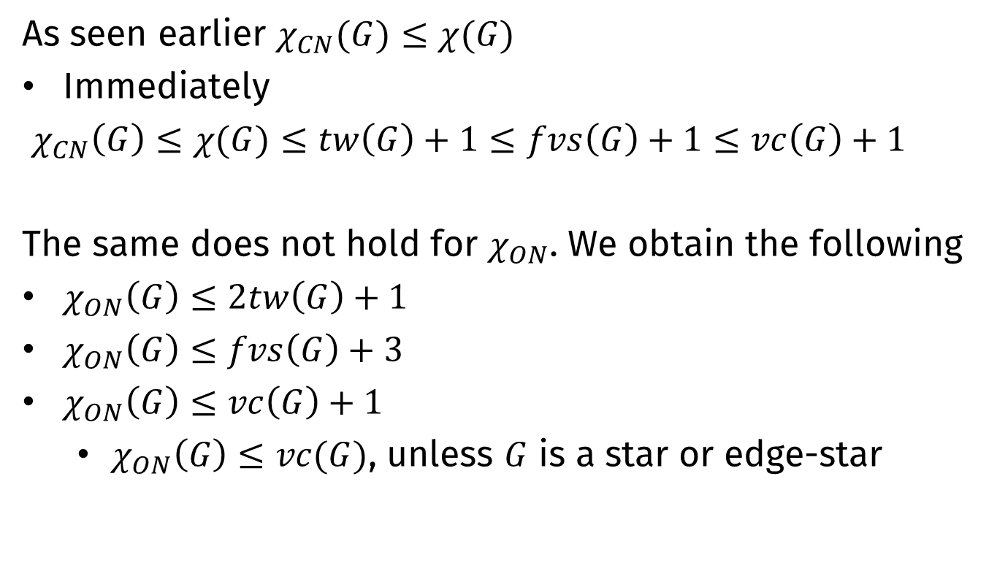
Combinatorial results
As seen earlier $χ_{CN}(G)≤χ(G)$
Immediately
$χ_{CN}\left(G\right)≤χ(G)≤tw\left(G\right)+1≤fvs\left(G\right)+1≤vc\left(G\right)+1$
The same does not hold for $χ_{ON}$. We obtain the following
$χ_{ON}\left(G\right)≤2tw\left(G\right)+1$
$χ_{ON}\left(G\right)≤fvs\left(G\right)+3$
$χ_{ON}\left(G\right)≤vc\left(G\right)+1$
  $χ_{ON}\left(G\right)≤vc(G)$, unless $G$ is a star or edge-star
…
…

Slide 10
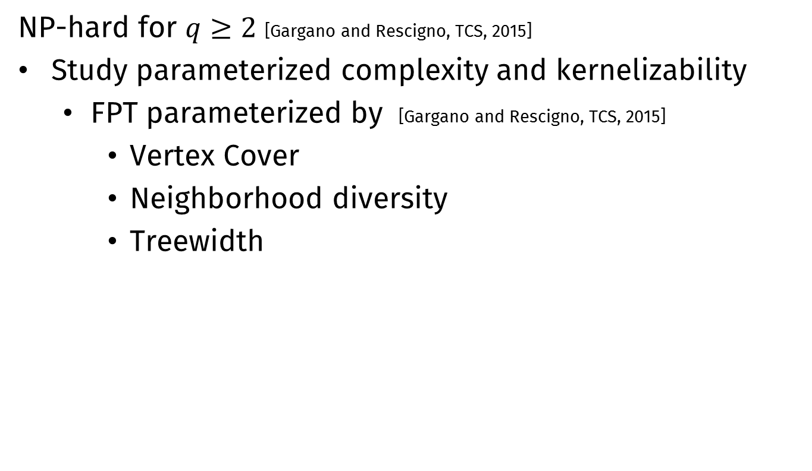
Background
NP-hard for $q≥2$ [Gargano and Rescigno, TCS, 2015]
Study parameterized complexity and kernelizability
  FPT parameterized by [Gargano and Rescigno, TCS, 2015]
    Vertex Cover
    Neighborhood diversity
    Treewidth

Slide 11
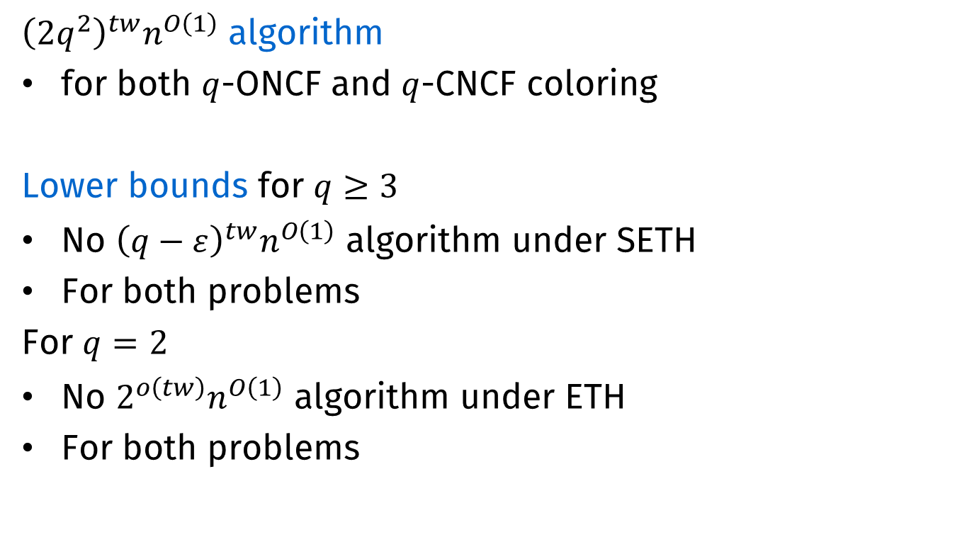
Algorithmic results
${\left(2q^{2}\right)}^{tw}n^{O\left(1\right)}$ algorithm
for both $q$-ONCF and $q$-CNCF coloring
Lower bounds for $q≥3$
No ${\left(q−ε\right)}^{tw}n^{O\left(1\right)}$ algorithm under SETH
For both problems
For $q=2$
No $2^{o\left(tw\right)}n^{O\left(1\right)}$ algorithm under ETH
For both problems

Slide 12


Kernelization results
Kernelization parameterized by Vertex Cover
2-CNCF-Coloring has a polynomial kernel (up next)
$q$-CNCF-Coloring has no polynomial kernel¹ for $q≥3$
$q$-ONCF-Coloring has no polynomial kernel¹ for $q≥2$
  Both results proven by cross-composition
  See https://arxiv.org/pdf/1905.00305
¹Unless $NP⊆coNP/poly$
  Polynomial kernelization
  There is a polynomial-time algorithm that does the following
  Input Instance $(x,k)$
  Output Instance $(x^{′},k^{′})$ such that:
  $\left|x^{′}\right|≤poly\left(k\right)$
  $k′≤poly(k)$
  $(x^{′},k^{′})$ is a yes-instance if and only if $(x,k)$ is
Efficient
Small bound
Correct

Slide 13
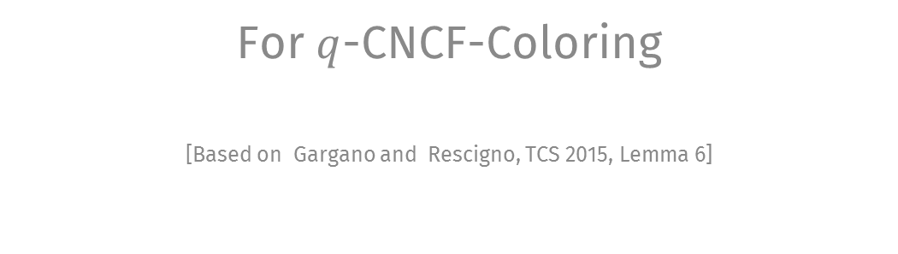
A general reduction rule
For $q$-CNCF-Coloring
[Based on Gargano and Rescigno, TCS 2015, Lemma 6]
Notes:
Start at 17 min

Slide 14


Reducing number of twins
Let $S^{′}⊆S$. Suppose there are $>q+1$ vertices $v∉S$ with $N\left(v\right)=S′$. Mark $q+1$, remove the others.
$$q=3$$
s





$S$’

Slide 15







Correctness
Let $G′$ be the resulting graph
Suppose $G$ is $q$-CNCF-Colorable
  Color $G′$ similarly, ensuring that each vertex in $S$ keeps its conflict-free neighbor (if any)
$$G$$
$$G′$$
$$S$$
s
$$S$$
s
$S$’
$S$’

Slide 16

Correctness
Suppose $G′$ is $q$-CNCF-Colorable
  Use the same coloring on $G$
  Let $v$ be a removed vertex, color $v$ using a color already used twice on marked vertices
    Observe that such a color exists!
$$G$$
$$G′$$
$$S$$
s
$$S$$
s
$S$’
$S$’

Slide 17
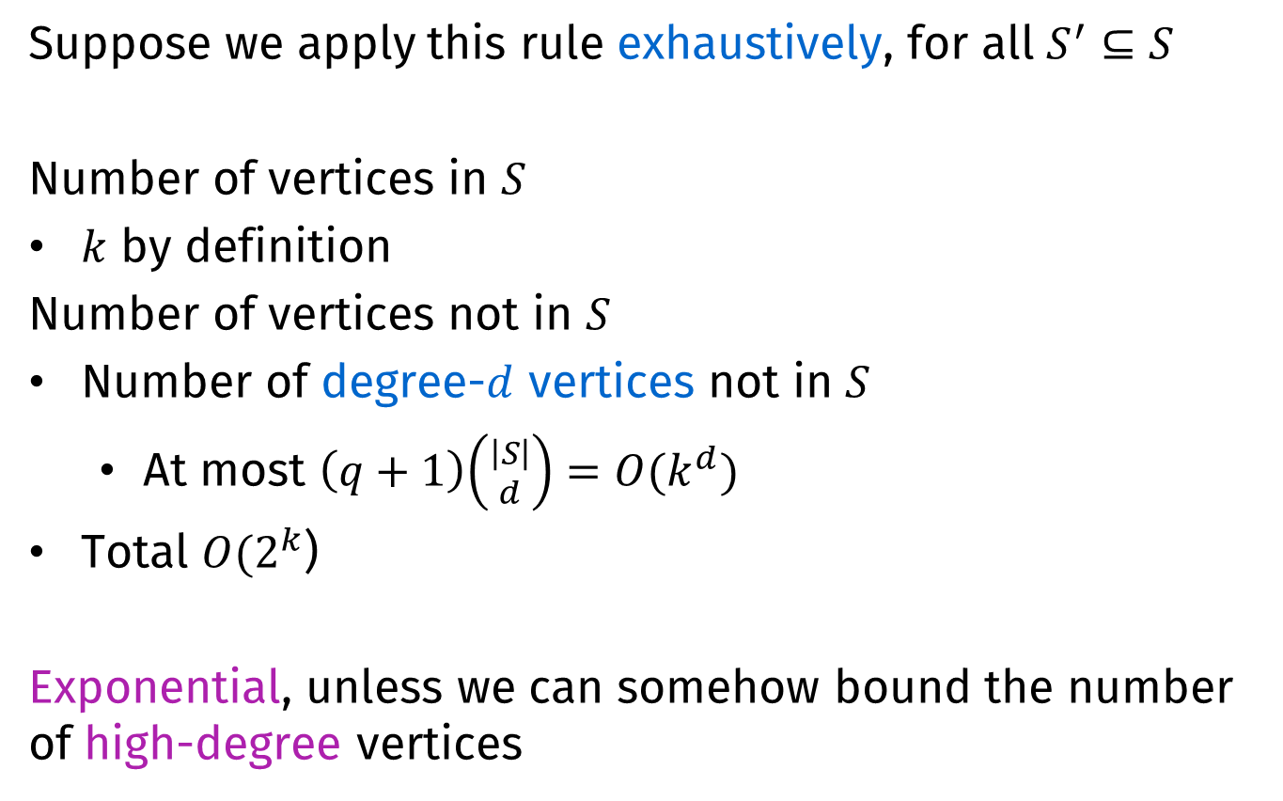
Effectiveness
Suppose we apply this rule exhaustively, for all $S^{′}⊆S$
Number of vertices in $S$
$k$ by definition
Number of vertices not in $S$
Number of degree-$d$ vertices not in $S$
  At most $\left(q+1\right)\left({\left|S\right| \atop d}\right)=O(k^{d})$
Total $O(2^{k}$)
Exponential, unless we can somehow bound the number of high-degree vertices

Slide 18
Polynomial kernel for
2-CNCF-Coloring
Parameterized by Vertex Cover size
Notes:
Start at 17 min

Slide 19
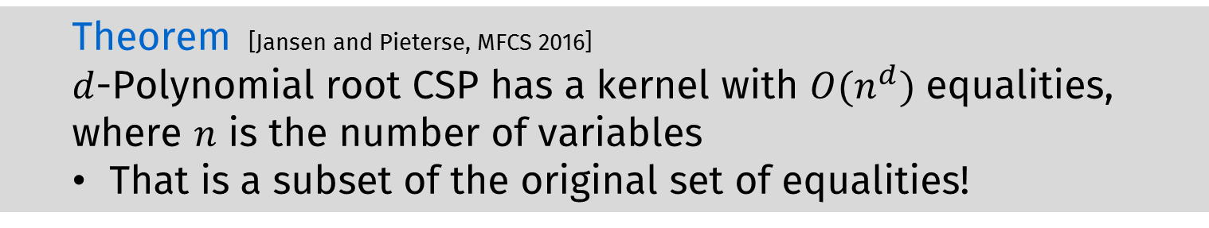
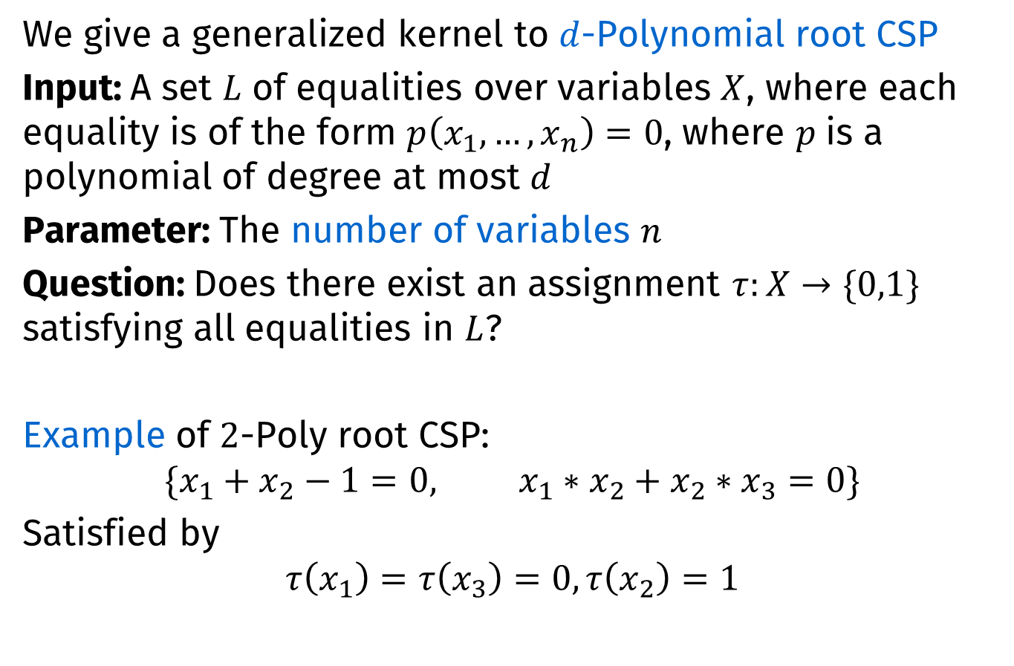
A generalized kernel
We give a generalized kernel to $d$-Polynomial root CSP
Input: A set $L$ of equalities over variables $X$, where each equality is of the form $p\left(x_{1},…,x_{n}\right)=0$, where $p$ is a polynomial of degree at most $d$
Parameter: The number of variables $n$
Question: Does there exist an assignment $τ:X→\{0,1\}$ satisfying all equalities in $L$?
Example of $2$-Poly root CSP:
$$\{x_{1}+x_{2}−1=0, {x_{1}∗x_{2}+x}_{2}∗x_{3}=0\}$$
Satisfied by
$$τ\left(x_{1}\right)=τ\left(x_{3}\right)=0, τ\left(x_{2}\right)=1$$
  Theorem [Jansen and Pieterse, MFCS 2016]
  $d$-Polynomial root CSP has a kernel with $O(n^{d})$ equalities, where $n$ is the number of variables
  That is a subset of the original set of equalities!

Slide 20
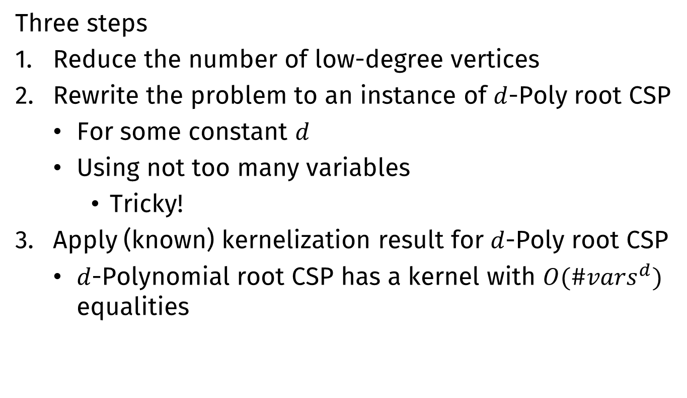
Kernelization: General idea
Three steps
Reduce the number of low-degree vertices
Rewrite the problem to an instance of $d$-Poly root CSP
  For some constant $d$
  Using not too many variables
    Tricky!
Apply (known) kernelization result for $d$-Poly root CSP
  $d$-Polynomial root CSP has a kernel with $O({\#vars}^{d})$ equalities

Slide 21
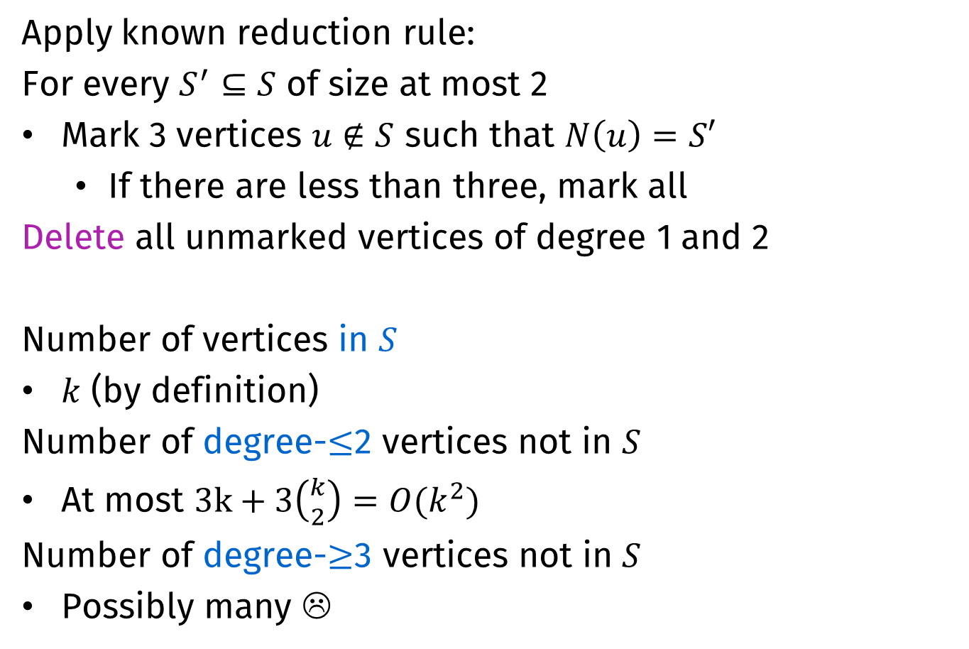
Removing low-degree vertices
Apply known reduction rule:
For every $S^{′}⊆S$ of size at most 2
Mark 3 vertices $u∉S$ such that $N\left(u\right)=S′$
  If there are less than three, mark all
Delete all unmarked vertices of degree 1 and 2
Number of vertices in $S$
$k$ (by definition)
Number of degree-$≤$2 vertices not in $S$
At most $3k+3\left({k \atop 2}\right)={O(k}^{2})$
Number of degree-$≥$3 vertices not in $S$
Possibly many ☹

Slide 22

Removing low-degree vertices
Add these to $S$
  Technically, this increases $|S|$ to $O(k^{2})$
  We ignore this for simplicity

Slide 23
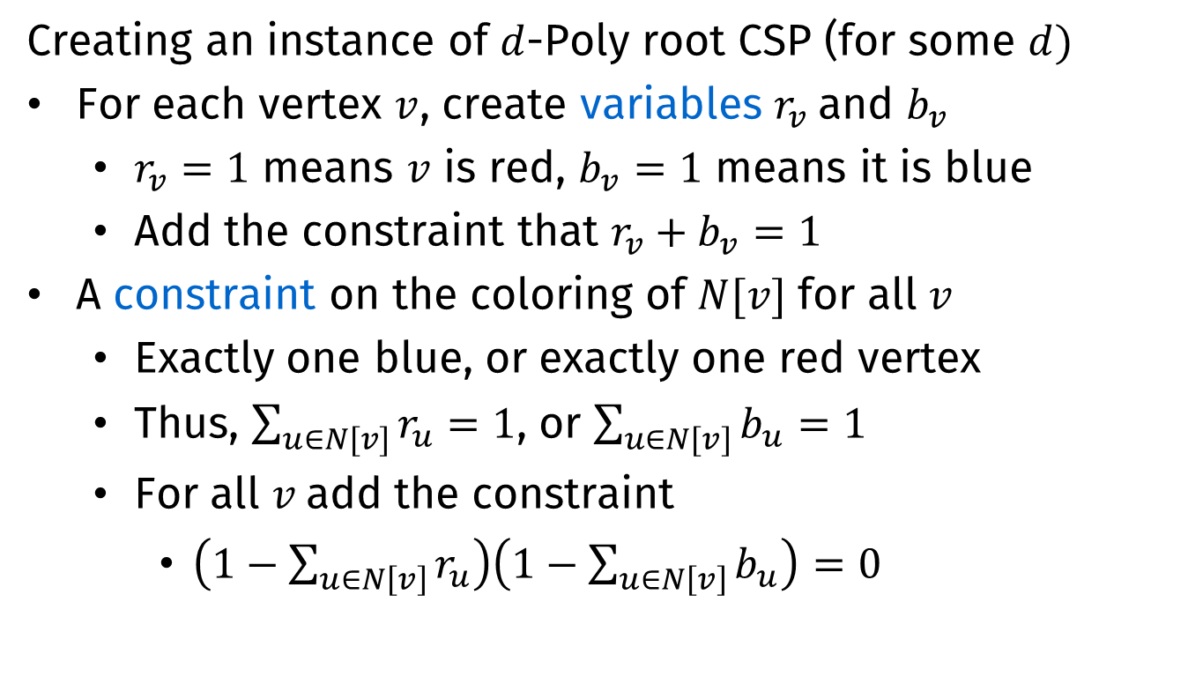
Rewriting: Basics
Creating an instance of $d$-Poly root CSP (for some $d)$
For each vertex $v$, create variables $r_{v}$and $b_{v}$
  $r_{v}=1$ means $v$ is red, $b_{v}=1$ means it is blue
  Add the constraint that $r_{v}+b_{v}=1$
A constraint on the coloring of $N[v]$ for all $v$
  Exactly one blue, or exactly one red vertex
  Thus, $\sum_{u∈N[v]}{r_{u}=1}$, or $\sum_{u∈N[v]}{b_{u}}=1$
  For all $v$add the constraint
    $\left(1−\sum_{u∈N\left[v\right]}{r_{u}}\right)\left(1−\sum_{u∈N\left[v\right]}{b_{u}}\right)=0$

Slide 24
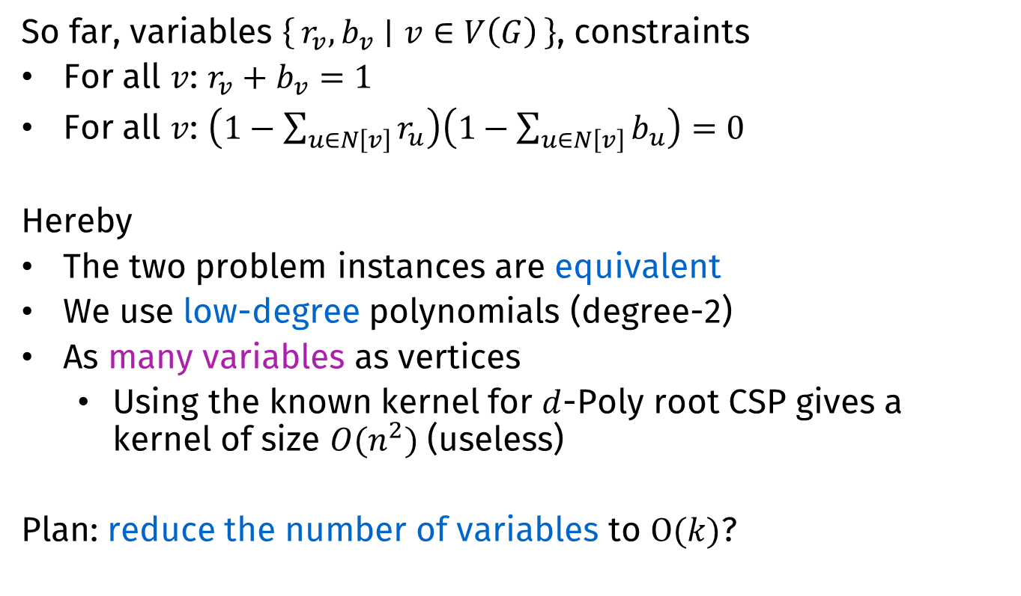
Rewriting: Continued
So far, variables $\left\{r_{v},b_{v} ∣ v∈V\left(G\right)\right\}$, constraints
For all $v$: $r_{v}+b_{v}=1$
For all $v$: $\left(1−\sum_{u∈N\left[v\right]}{r_{u}}\right)\left(1−\sum_{u∈N\left[v\right]}{b_{u}}\right)=0$
Hereby
The two problem instances are equivalent
We use low-degree polynomials (degree-2)
As many variables as vertices
  Using the known kernel for $d$-Poly root CSP gives a kernel of size $O(n^{2})$ (useless)
Plan: reduce the number of variables to $O(k)$?

Slide 25

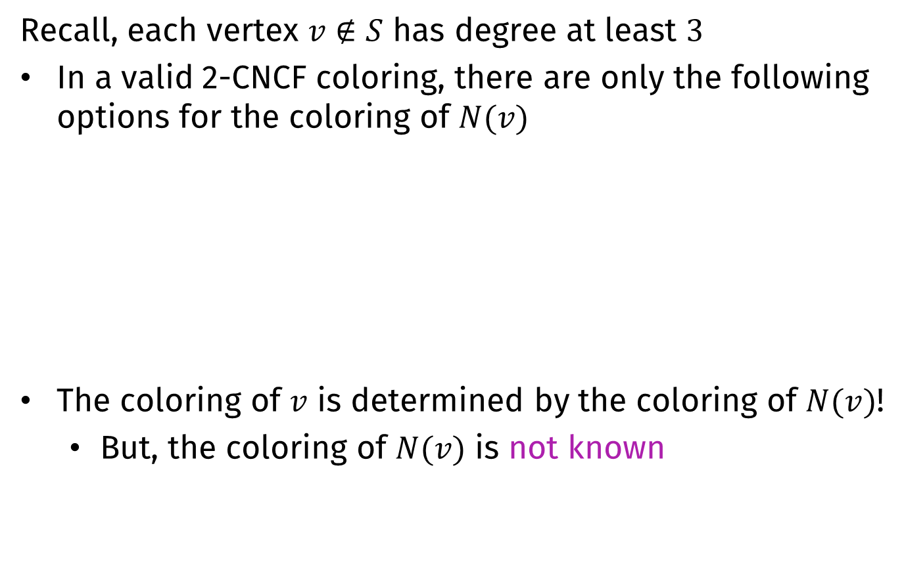



Reducing the number of variables
Recall, each vertex $v∉S$ has degree at least $3$
In a valid 2-CNCF coloring, there are only the following options for the coloring of $N(v)$
The coloring of $v$ is determined by the coloring of $N(v)$!
  But, the coloring of $N(v)$ is not known
S
S
S
S
$$v$$
$$v$$
$$v$$
$$v$$

Slide 26

Reducing the number of variables
Write $r_{v}$ as $f\left(r_{u_{1}},…, r_{u_{k}},b_{u_{1}},…,b_{u_{k}}\right)$ if $N\left(v\right)=\{u_{1},…,u_{k}\}$
  For low-degree polynomial $f$
  Then $b_{v}=1 −r_{v}=1−f(…)$
  Substituting $r_{v}$ by $f(…)$, reduces the number of variables to $2\left|S\right|=2k$

Slide 27

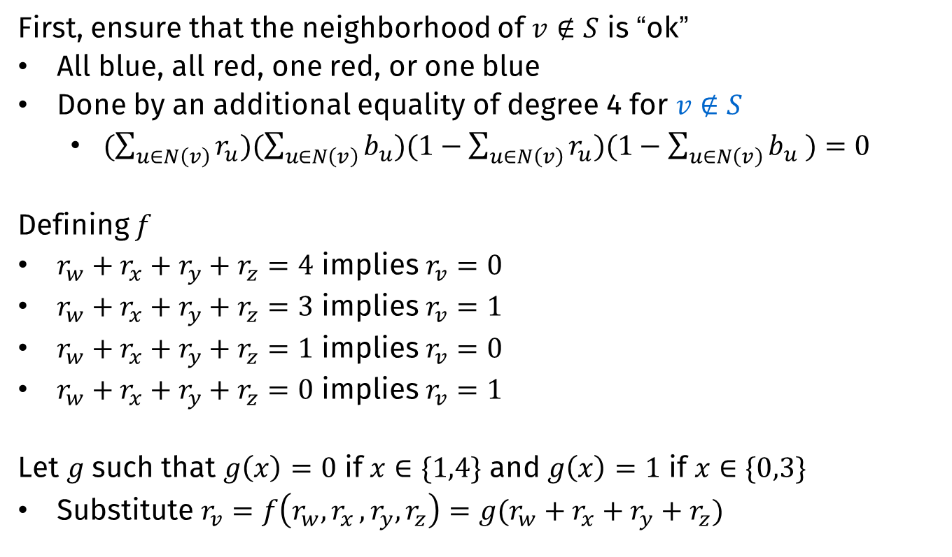





Finding $f$
First, ensure that the neighborhood of $v∉S$ is “ok”
All blue, all red, one red, or one blue
Done by an additional equality of degree 4 for $v∉S$
  $(\sum_{u∈N\left(v\right)}{r_{u}})(\sum_{u∈N\left(v\right)}{b_{u}})(1−\sum_{u∈N\left(v\right)}{r_{u}})(1−\sum_{u∈N\left(v\right)}{b_{u} )}=0$
Defining $f$
$r_{w}+r_{x}+r_{y}+r_{z}=4$ implies $r_{v}=0$
$r_{w}+r_{x}+r_{y}+r_{z}=3$ implies $r_{v}=1$
$r_{w}+r_{x}+r_{y}+r_{z}=1$ implies $r_{v}=0$
$r_{w}+r_{x}+r_{y}+r_{z}=0$ implies $r_{v}=1$
Let $g$ such that $g\left(x\right)=0$ if $x∈\{1,4\}$ and $g\left(x\right)=1$ if $x∈\{0,3\}$
Substitute $r_{v}=f\left(r_{w}{,r}_{x},r_{y},r_{z}\right)=g(r_{w}+r_{x}+r_{y}+r_{z})$
$$w$$
$$x$$
$$v$$
$$y$$
$$z$$

Slide 28
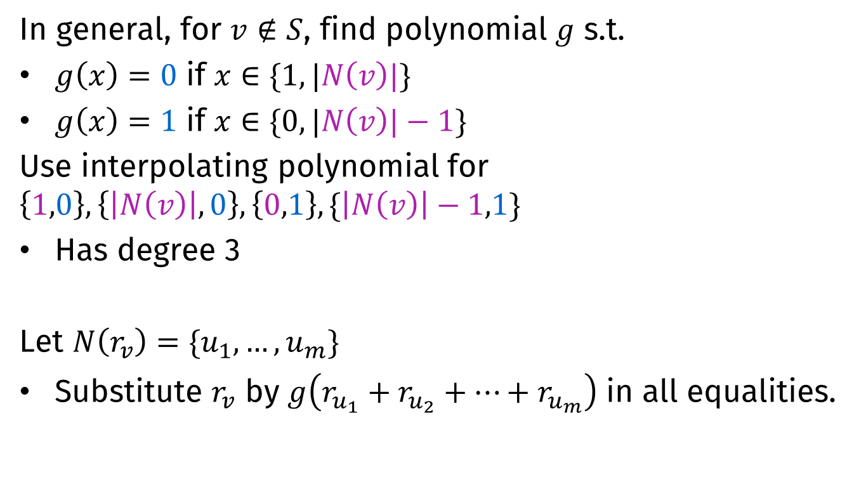
Finding $f$
In general, for $v∉S$, find polynomial $g$ s.t.
$g\left(x\right)=0$ if $x∈\{1, |N\left(v\right)|\}$
$g\left(x\right)=1$ if $x∈\{0, |N\left(v\right)|−1\}$
Use interpolating polynomial for $\left\{1,0\right\},\left\{\left|N\left(v\right)\right|,0\right\},\left\{0,1\right\},\{\left|N\left(v\right)\right|−1,1\}$
Has degree 3
Let $N\left(r_{v}\right)=\{u_{1},…,u_{m}\}$
Substitute $r_{v}$ by $g\left(r_{u_{1}}+r_{u_{2}}+…+r_{u_{m}}\right)$ in all equalities.
Notes:
Note: the colors in the formulas in the first two lines are wrong. You can change them, but powerpoint refuses to save these changes. How nice.

Slide 29
Resulting Poly root CSP instance
Variables $\left\{r_{v},b_{v} ∣ v∈S\right\}$, constraints
For all $v$: $r_{v}+b_{v}=1$
For all $v$: $\left(1−\sum_{u∈N\left[v\right]}{r_{u}}\right)\left(1−\sum_{u∈N\left[v\right]}{b_{u}}\right)=0$
  With for $v∉S$ $r_{v}$ substituted by $f(…)$, $b_{v}$ by $1−f(…)$
For all $v∉S$:
$(\sum_{u∈N\left(v\right)}{r_{u}})(\sum_{u∈N\left(v\right)}{b_{u}})(1−\sum_{u∈N\left(v\right)}{r_{u}})(1−\sum_{u∈N\left(v\right)}{b_{u} )}=0$

Slide 30
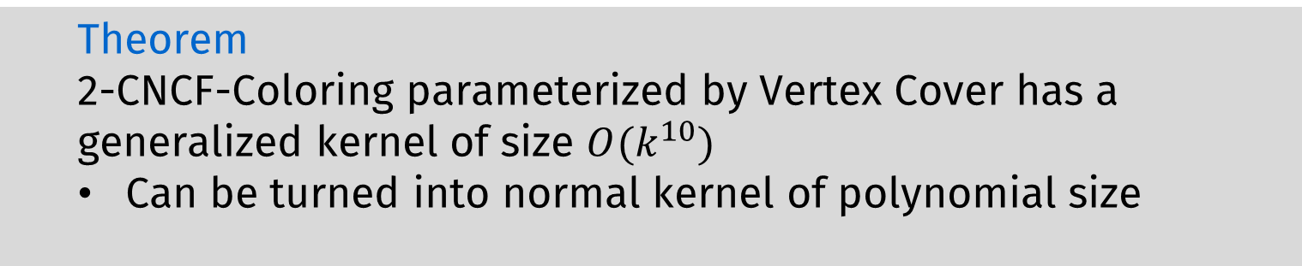
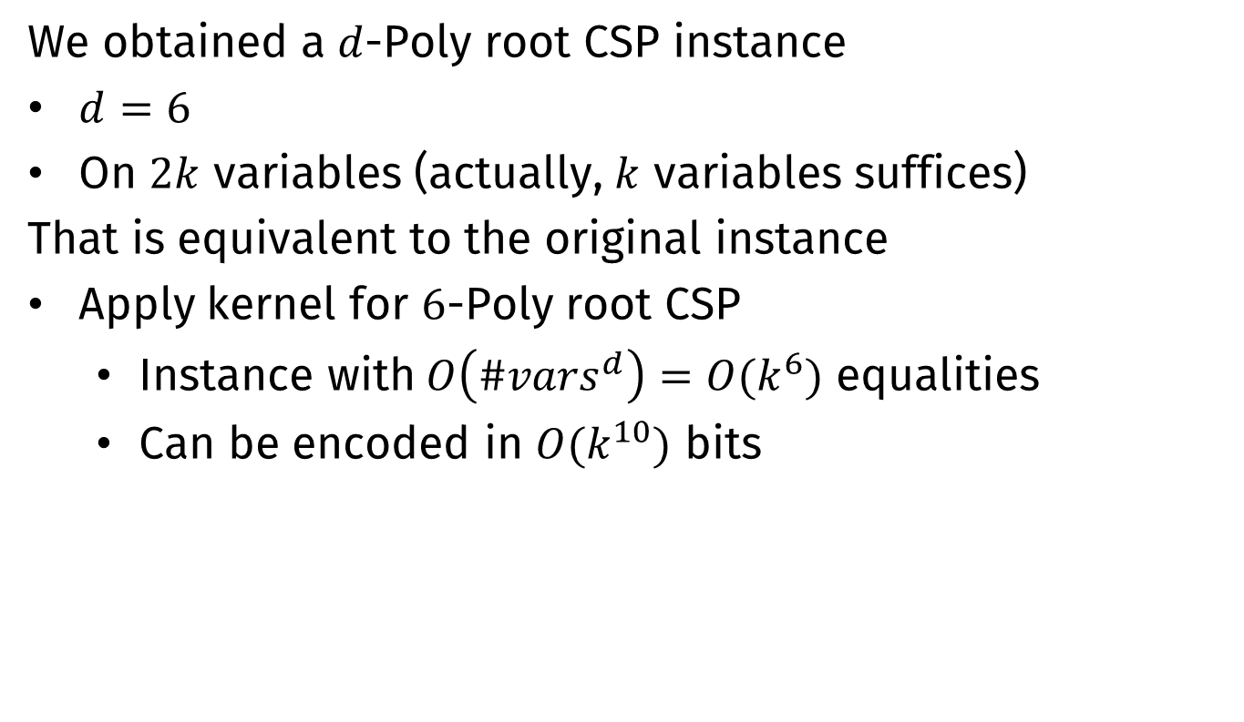
Kernelization
We obtained a $d$-Poly root CSP instance
$d=6$
On $2k$ variables (actually, $k$ variables suffices)
That is equivalent to the original instance
Apply kernel for $6$-Poly root CSP
  Instance with$O\left({\#vars}^{d}\right)=O(k^{6})$ equalities
  Can be encoded in $O(k^{10})$ bits
  Theorem
  2-CNCF-Coloring parameterized by Vertex Cover has a generalized kernel of size $O(k^{10})$
  Can be turned into normal kernel of polynomial size

Slide 31

Conclusion
2-CNCF-Coloring parameterized by vertex cover has a polynomial kernel
  $q$-CNCF-Coloring for $q≥3$ and $q$-ONCF-Coloring do not¹
    Not even for the extension problem
FPT algorithm and lower bounds
  Parameterized by treewidth
(Tight) combinatorial bounds
Open questions
Tight algorithmic bounds parameterized by treewidth
Is the $O(k^{10})$ bound tight for 2-CNCF-Coloring?
  Probably not
  THANK YOU
¹Unless $NP⊆coNP/poly$

